Slide 1

Music
Intent
Intent

Slide 2
Music
At Springfield Infant School and Nursery, we aim to ensure that our children enjoy a wide range of music and learn to express themselves through singing, composition and dance. We will enable our children to understand that music has a purpose and is created to be appreciated and shared with an audience. We will provide our children with the skills to sing and compose confidently by developing their knowledge of the structural layers and organisation of music. Through fostering an early understanding of the many exciting genres, and how music has shaped societies and the wider world; we aim to develop a life-long passion for music.
Intent

Slide 3
Music
Aims of the Music Curriculum
The national curriculum for music aims to ensure that all pupils:
perform, listen to, review and evaluate music across a range of historical periods, genres, styles and traditions, including the works of the great composers and musicians
learn to sing and to use their voices, to create and compose music on their own and with others, have the opportunity to learn a musical instrument, use technology appropriately and have the opportunity to progress to the next level of musical excellence
understand and explore how music is created, produced and communicated, including through the inter-related dimensions: pitch, duration, dynamics, tempo, timbre, texture, structure and appropriate musical notations.
Intent

Slide 4
Music
Early Years
In Early Years, music is taught through Expressive Arts and Design. Our curriculum is designed to provide children with regular opportunities to engage with music, enabling them to explore different genres of music and respond to them, play different musical instruments and find different ways to make music. Children are encouraged to do this by:
Singing a variety of songs both in groups and on their own; some well-known and some improvised; looking at the pitch and melodic shape.
Playing a variety of instruments with increasing control to express feelings and ideas.
Create music collaboratively and individually.
Listen attentively to a range of music and talk about it, expressing feelings and thoughts.
Intent

Slide 5
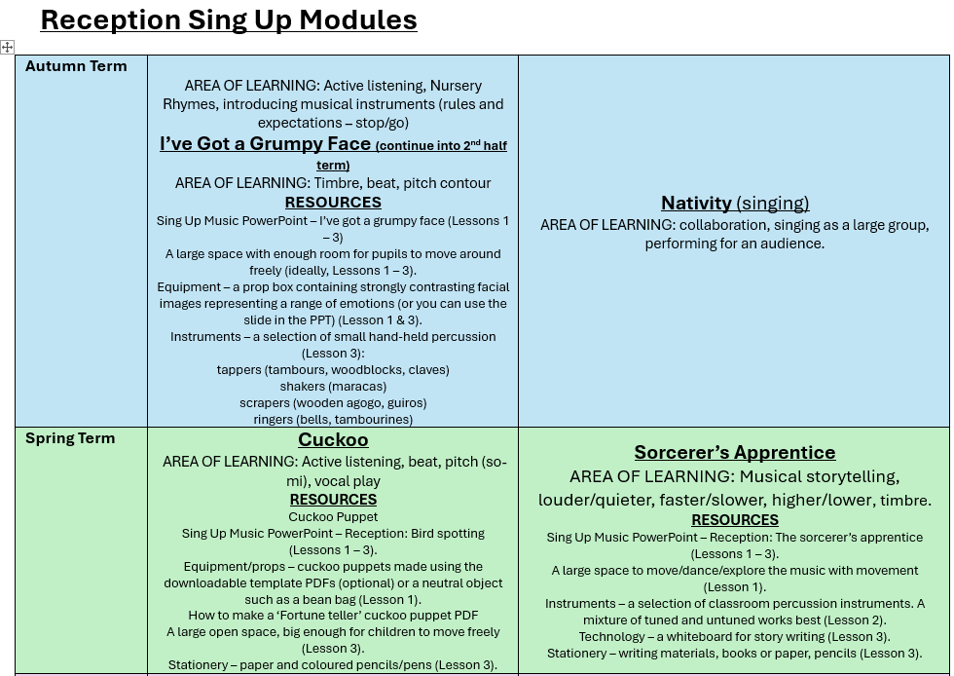
Content and sequence - EYFS to Key Stage 1
Intent

Slide 6
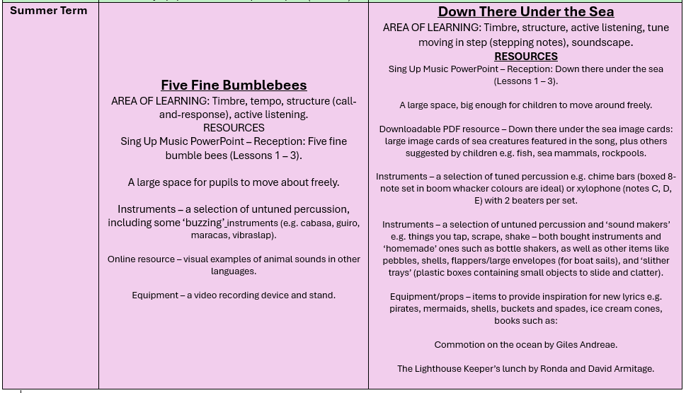
Content and sequence - EYFS to Key Stage 1
Intent

Slide 7
Spaced Retrieval Practice Approach
Our music curriculum is delivered through a series of modules which are deliberately spaced throughout the academic year with opportunities to introduce and revisit key concepts. This approach enables staff to deepen pupil understanding and embed learning.
Intent

Slide 8
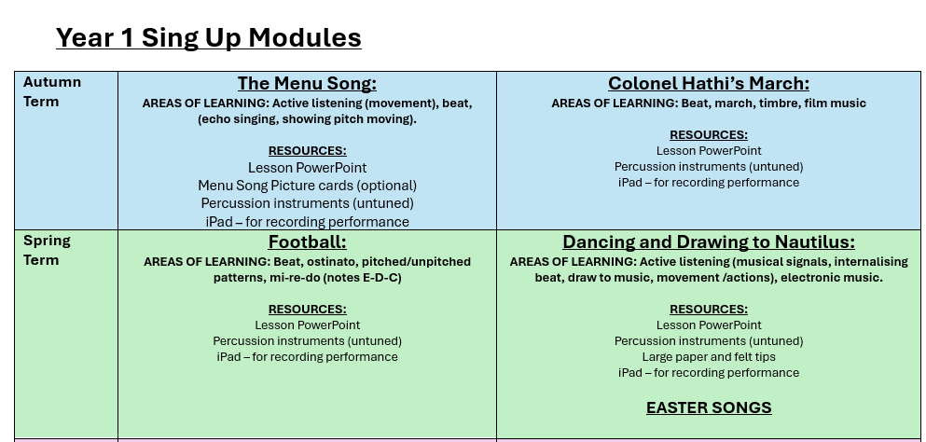
Year 1 & 2 Overview
Intent

Slide 9
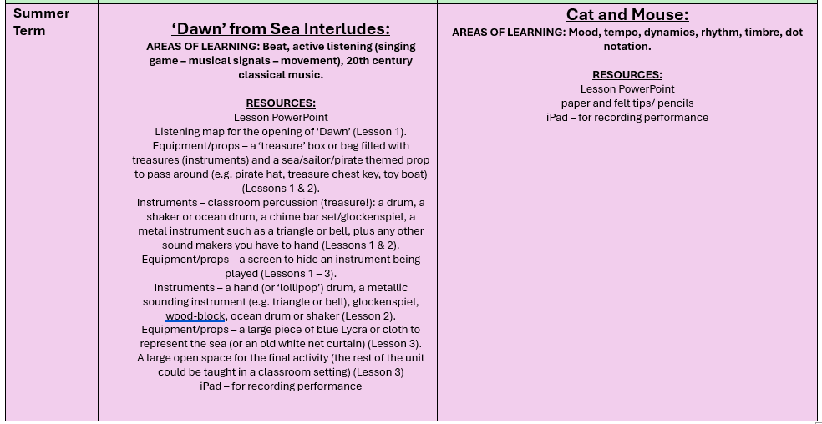
Year 1 & 2 Overview
Intent

Slide 10
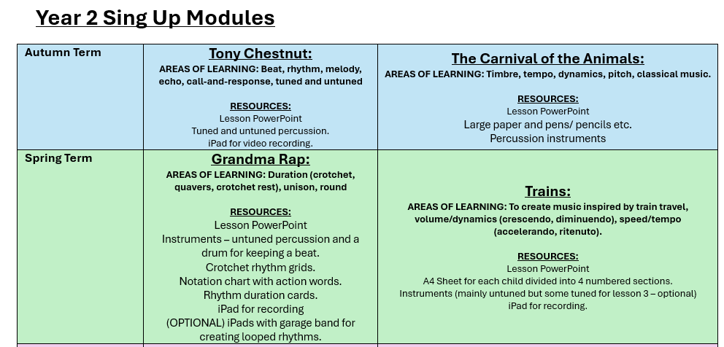
Year 1 & 2 Overview
Intent

Slide 11
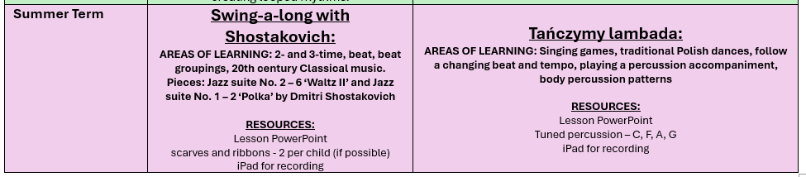
Year 1 & 2 Overview
Intent

Slide 12
Music
Implementation
Implementation

Slide 13
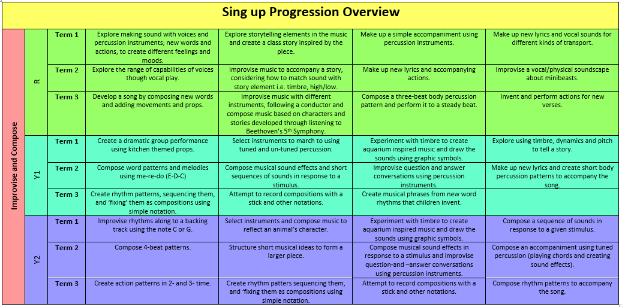
Implementation

Slide 14
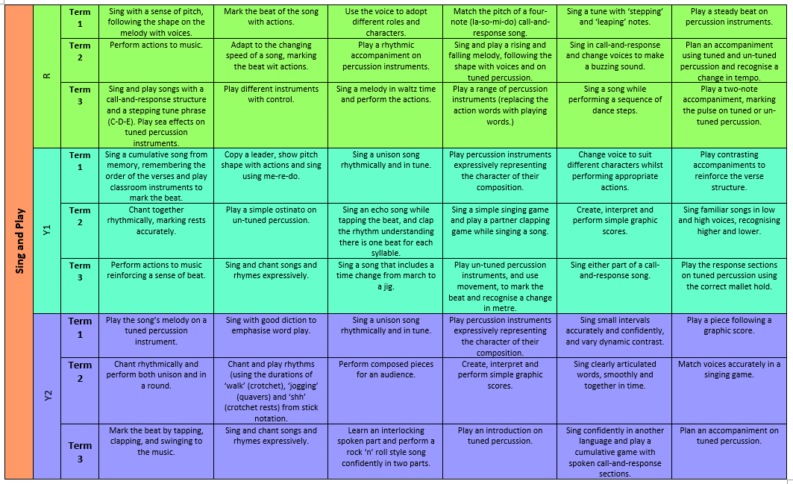
Implementation

Slide 15
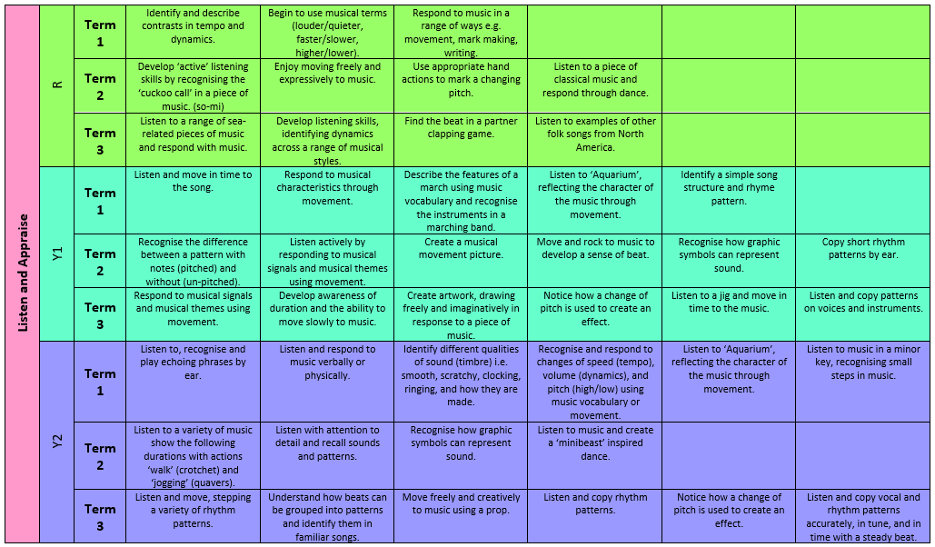
Implementation

Slide 16
How do we teach Music?
At Springfield Infant School and Nursery, music is taught across each year group in modules that enable pupils to study in depth key musical understanding, skills and vocabulary. Each module aims to activate and build upon prior learning, including EYFS, to ensure better cognition and retention. Each module is carefully sequenced to enable pupils to purposefully layer learning from previous sessions to facilitate the acquisition and retention of key musical knowledge. Each module is revisited either later in the year or in the following year as part of a spaced retrieval practice method to ensure pupils retain key knowledge and information.
Implementation

Slide 17
Music
Impact
Impact

Slide 18
Assessment
At the end of each block, teachers assess children’s knowledge and understanding against specific criteria. Knowledge is revisited at the beginning of subsequent lessons through a spaced practice approach to support retention.
Pupil book study
Subject leaders undertake pupil book studies to monitor the effectiveness of teaching and learning. This includes learning impact discussions with small groups of children using questioning to check and ensure vocabulary and knowledge has been learnt and understood. Subject leaders complete a report to inform teaching staff on areas of strength and those requiring improvement. This feedback informs future planning.
Impact

