Slide 1

RE
Intent
Intent

Slide 2
RE
Aims of the RE Curriculum
At Springfield Infant and Nursery, we aim to ensure that our children develop an understanding of Christianity, alongside a wider knowledge of world faiths. Through our teaching we will actively promote the British values of mutual respect and tolerance of different faiths and beliefs. We want our children to know about the different faith systems, but also understand why these are so important to people. We aim to broaden their awareness of the beliefs, values and traditions of other individuals, societies, communities and cultures; so that they can become thoughtful, tolerant and appreciative members of the diverse society that they live in.
Intent

Slide 3
RE
Aims of the RE Curriculum
As the RE curriculum is agreed on by the Local Authority, there are no statutorily required topics to be covered. The RE curriculum framework document does state the ways a well-designed syllabus will benefit children, help them to grow and understand their world:
Whilst RE is not part of the national curriculum for RE guidance for teaching RE aims to ensure that all pupils:
develop an understanding of concepts and mastery of skills to make sense of religion and belief, at an appropriate level of challenge for their age.
are provided with opportunities to develop positive attitudes and values to reflect and relate their learning in RE to their own experiences.
have the opportunity to learn that there are those who do not hold religious belief and have their own philosophical perspectives, and subject matter should facilitate integration and promotion of shared values.
are provided with an appropriate balance between and within Christianity, other principal religions, and, where appropriate other religious traditions and world views, across the key stages as a whole, making appropriate links with other parts of the curriculum
Not all religions need to be studied at the same depth or in each key stages, but all religions that are studied should be done so in a way that is coherent and promotes progression.
Intent

Slide 4
RE
Early Years
In Early Years, RE is taught through Personal, Social and Emotional Development through which they are able to form positive attitudes about the differences between people and towards other’s views, as well as through Understanding the World where children are helped to make sense of their physical world and their community, whilst fostering their understanding of our culturally, socially, technologically and ecologically diverse world.
Children are encouraged to do this by:
accessing resources that reflect the diversity of life in modern Britain
celebrating and valuing cultural, religious and community events and experiences
thinking about the perspective of others
Intent

Slide 5
RE
Implementation
Implementation

Slide 6
RE
Jigsaw RE
RE teaching at Springfield Infant School and Nursery is taught through the Jigsaw RE programme which provides guidance for the knowledge and skills necessary to develop pupils understanding of RE through both Early Years and Key Stage 1.
Through the Jigsaw RE scheme of work, children develop an understanding of their own and others’ worldviews that underpin growth of empathy and respect. Children learn to appreciate that we all see the world through the lens that has been formed by our experiences, upbringing, culture etc and that this influences our decision-making and our own way of seeing the world is so valuable.
Children are taught through an enquiry method where the key question demands an answer that weighs up ‘evidence’ and reaches a conclusion based on this. This necessitates children using their subject knowledge and applying it to the enquiry question, rather than this knowledge being an end in itself.
Intent

Slide 7
RE
Jigsaw RE
Jigsaw RE focuses on critical thinking skills, on personal reflection into the child’s own thoughts and feelings, on growing subject knowledge and nurturing spiritual development and uses the following 4-step model.
Step 1 Engagement:
Piece 1
The human experience underpinning the key question is explored here within the children’s own experience, whether that includes a worldview/religion or not. So for example, a human experience underpinning the question, ‘What is the best way for a Sikh to show commitment to God?’ is ‘commitment’, so piece 1 aims to help all children resonate with the experience of ‘commitment’ in their own lives. Relating to this human experience acts as a schema to then help them better understand the worldview being studied (which may be very much outside of their experience).
Step 2 Investigation:
Piece 2
The teacher guides the children through the enquiry, children gaining subject knowledge carefully selected to assist their thinking about the key question. The plans for pieces 2, 3 and 4 cover the necessary subject knowledge to answer the enquiry questions. This ensures that the acquisition of the factual information about the religion / belief system being studied is embedded and important, but can be applied critically so that it is not an end in itself.
Intent

Slide 8
RE
Jigsaw RE
Step 3 investigation:
Piece 5
This piece draws together the children’s learning and their conclusions about the key question of that enquiry. There is an assessment opportunity included which gauges the children’s progress by using the descriptors provided. The activity provides evidence of their learning in each enquiry.
Step 4 expression:
Piece 6
Children are taken back to step 1, their own experience, to reflect on how this enquiry might have influenced their own starting points and beliefs.
Pause points & Reflections
Using the ‘pause points’ and ‘help me reflect’ sections, helps children to relax and calm their minds, and allows them to bring their awareness / attention to the present moment. Children need to develop the ability to be aware of their own thoughts and feelings. This helps them to develop their personal spirituality, it also allows them the time to further embed their learning, and consider key teaching points. It can additionally lead to a greater empathy with, and understanding of, believers or followers of that worldview.
Intent

Slide 9
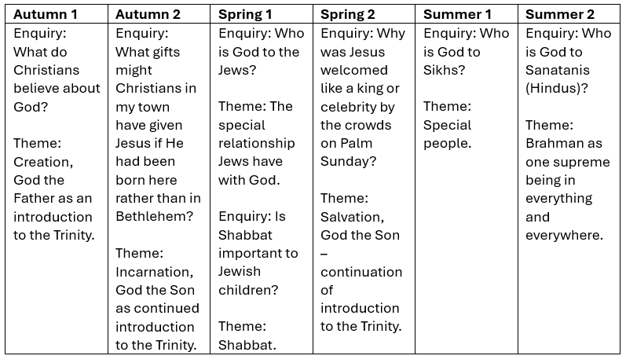
Content and sequence
Year 1
Implementation

Slide 10
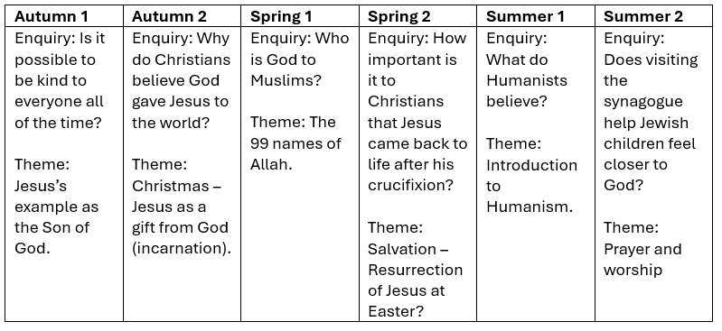
Content and sequence
Year 2
Implementation

Slide 11
RE
Impact
Impact

Slide 12
Assessment
At the end of each unit, teachers will assess children’s knowledge and understanding of the key question that has been the focus of teaching and learning.
Pupil book study
Subject leaders undertake pupil book studies to monitor the effectiveness of teaching and learning. This includes learning impact discussions with small groups of children using questioning to check and ensure vocabulary and knowledge has been learnt and understood. Subject leaders complete a report to inform teaching staff on areas of strength and those requiring improvement. This feedback informs future planning.
Impact

