Slide 1

Mathematics
Intent
Intent

Slide 2
Mathematics
Mathematics is an important creative discipline that helps us to understand the world. We want all pupils at Springfield Infant School & Nursery to experience the beauty, power and enjoyment of mathematics and develop a sense of curiosity about the subject along with a clear understanding. At Springfield Infants we believe all children can achieve in mathematics. We foster positive ‘can do’ attitudes and we promote the fact that ‘We can all do maths! Pupils are encouraged to think mathematically and are introduced to new concepts using the Concrete, Pictorial and Abstract (CPA) approach. Using real life contexts and manipulative resources, helps children to develop skills they can use in their everyday lives. It gives Maths meaning. It makes Maths more fun! We use mistakes and misconceptions as an essential part of learning and provide challenge through rich and sophisticated problem solving tasks. We teach in a precise way which makes it possible for all pupils to engage successfully with tasks at the expected level of challenge. Concepts are often explored together as a group or with a learning partner to make mathematical relationships explicit and strengthen pupils’ understanding of mathematical connectivity. Precise questioning during lessons ensures that children develop fluent technical proficiency and think deeply about the underpinning mathematical concepts.
Intent

Slide 3
Mathematics
Aims of the Mathematics Curriculum
The national curriculum for mathematics aims to ensure that all pupils:
Become fluent in the fundamentals of mathematics, including through varied and frequent practice with increasingly complex problems over time, so that pupils develop conceptual understanding and the ability to recall and apply knowledge rapidly and accurately.
Reason mathematically by following a line of enquiry, conjecturing relationships and generalisations, and developing an argument, justification or proof using mathematical language
Can solve problems by applying their mathematics to a variety of routine and non routine problems with increasing sophistication, including breaking down problems into a series of simpler steps and persevering in seeking solutions.
Intent

Slide 4
A Mastery Approach to Mathematics
Best practice shows that mastery of small, cumulative steps builds a solid foundation of deep mathematical understanding. At Springfield Infants, through the Power maths scheme, this means that we are teaching for depth and secure understanding, spending enough time learning each concept so that the children truly master it. Through small steps planning, teachers will expose mathematical concepts gradually, enabling children to apply their new knowledge and skills in multiple ways.
Intent

Slide 5
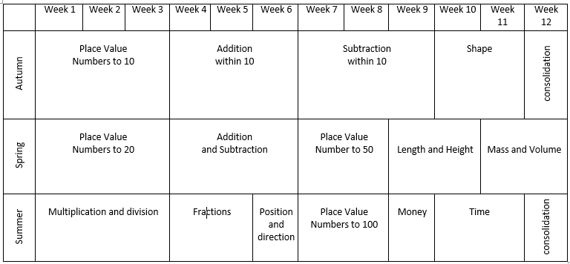
Year 1 Overview
Intent

Slide 6
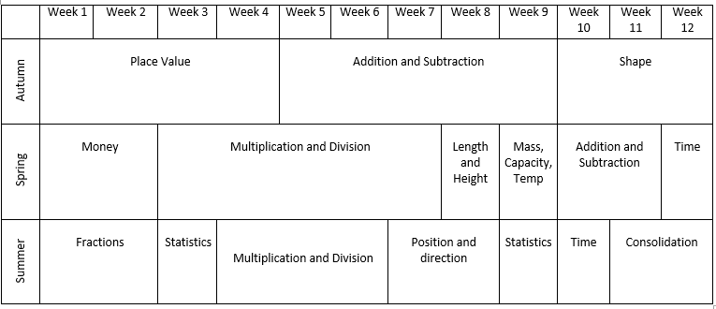
Year 2 Overview
Intent

Slide 7
Mathematics
Implementation
Implementation

Slide 8

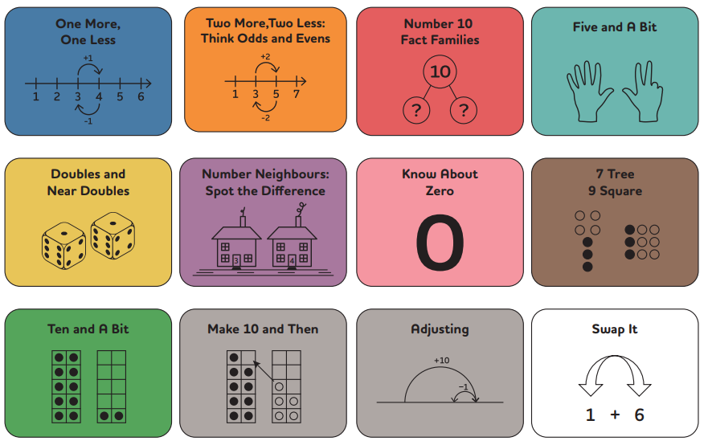
Number Fluency
Efficient, accurate recall of key number facts and procedures is essential for fluency, freeing pupils’ minds to think deeply about concepts and problems. Through Number Sense Maths, children are taught to solve addition and subtraction facts by applying key visuals, models and calculation strategies. Using the 12 strategies taught within the programme, children ‘use what they know to work out what they don’t know’. Explicit teaching of derived fact strategies is the most efficient route to fluency in addition and subtraction facts.
Intent

Slide 9

Power Maths at
Springfield Infants
Each lesson has a progression, with a central flow that draws the main learning into focus. There are different elements, informed by research into best practice in maths teaching, that bring the lessons to life:
Discover – each lesson begins with a problem to solve, often a real-life example, sometimes a puzzle or a game. These are engaging and fun, and designed to get all children thinking.
Share – the class shares their ideas and compares different ways to solve the problem, explaining their reasoning with hands-on resources and drawings to make their ideas clear. Children are able to develop their understanding of the concept with input from the teacher.
Think together – the next part of the lesson is a journey through the concept, digging deeper and deeper so that each child builds on secure foundations while being challenged to apply their understanding in different ways and with increasing independence.
Practice – now children practice individually or in small groups, rehearsing and developing their skills to build fluency, understanding of the concept and confidence.
Reflect – finally, children are prompted to reflect on and record their learning from each session and show how they have grasped the concept explored in the lesson.
Implementation

Slide 10
Power Maths at
Springfield Infants
CPA – Concrete / Pictorial / Abstract
CONCRETE – Children use concrete objects to help them make sense of the concept or problem; this could be anything from real or plastic fruit, to straws, counters, cubes or something else meaningful. Whatever the objects are, they can be moved, grouped and rearranged to illustrate the problem.
PICTORIAL – This stage uses pictorial representations of objects to let children ‘see’ what particular maths problems look like. It helps them make connections between concrete and pictorial presentations and the abstract maths concept.
ABSTRACT – Our ultimate goal is for children to understand abstract maths concepts, signs and notation and, of course, some children will reach this stage far more quickly than others. To work with abstract concepts, a child needs to be comfortable with the meaning of, and relationship between, concrete, pictorial and abstract models of representation.
The C-P-A approach is not linear, and children may need different types of models at different times.
Implementation

Slide 11
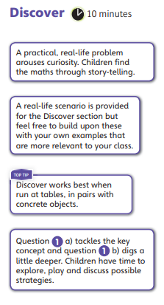
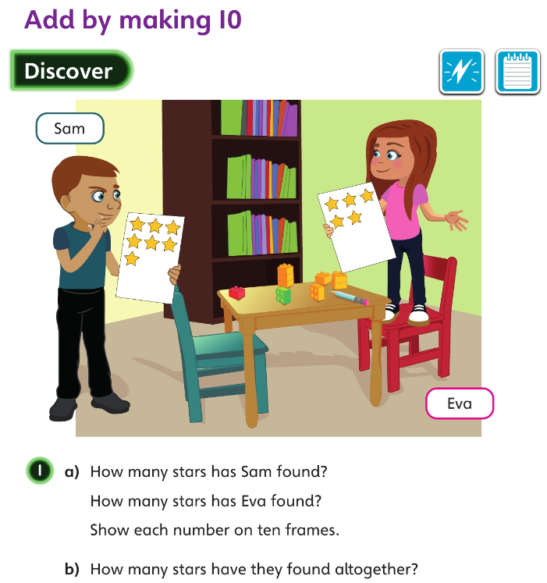
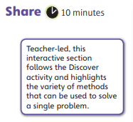
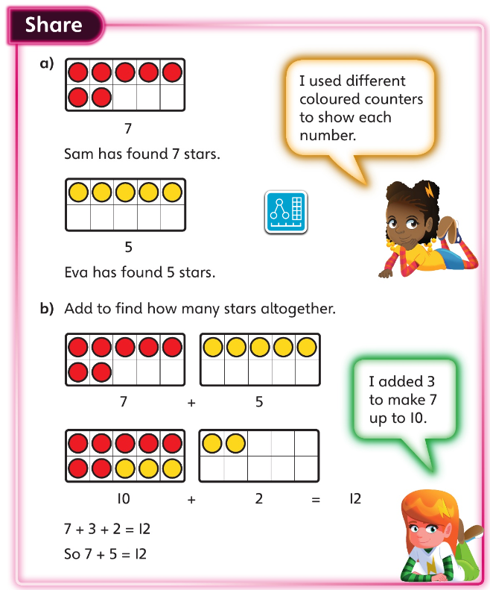
Implementation

Slide 12
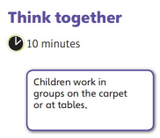


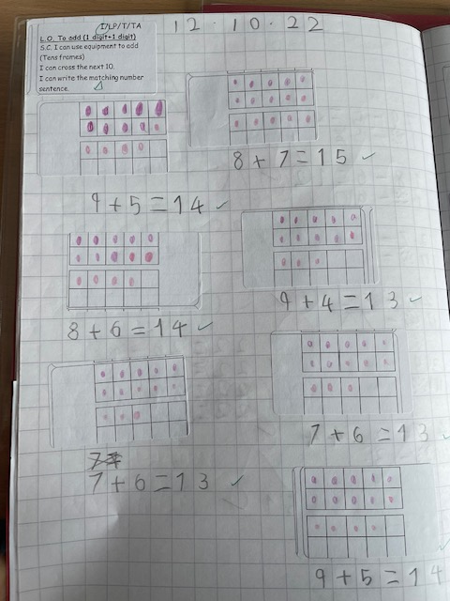
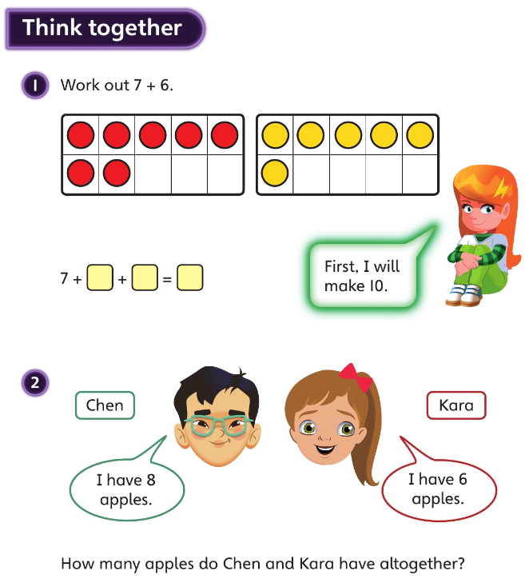
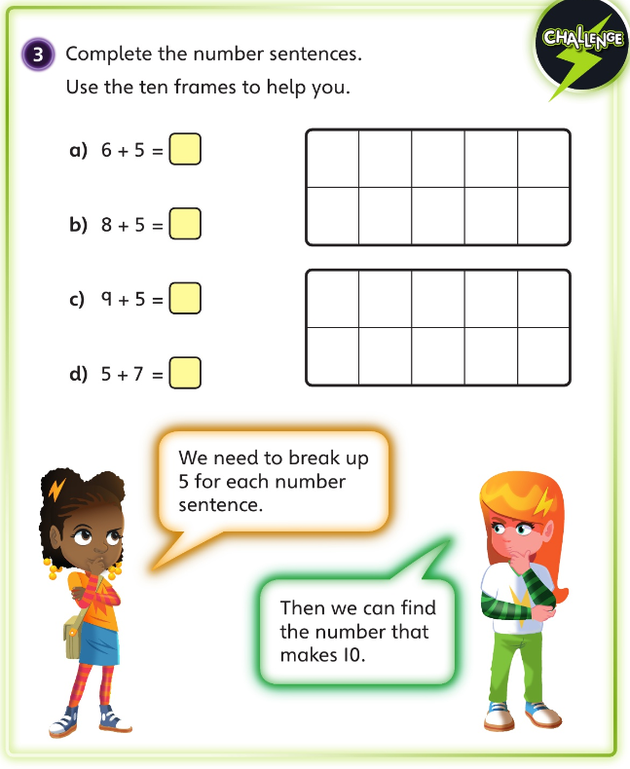
Implementation

Slide 13
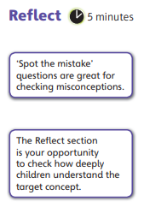
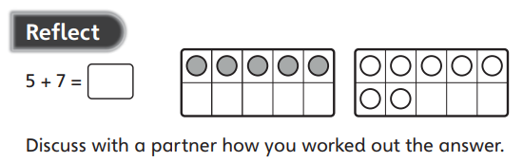
Implementation

Slide 14
Mathematics
Impact
Impact

Slide 15
Assessment
Children in Reception…
Each term, children in Year 1 and 2 undertake a maths test, assessing the content taught that term as well as previous learning. Assessment data is analysed by teachers and SLT and used to inform future planning.
Pupil book study
Subject leaders undertake pupil book studies to monitor the effectiveness of teaching and learning. This includes learning impact discussions with small groups of children using questioning to check and ensure vocabulary and knowledge has been learnt and understood. Subject leaders complete a report to inform teaching staff on areas of strength and those requiring improvement. This feedback informs future planning.
Impact

