Slide 1

Computing
Intent

Slide 2
Computing
At Springfield Infants School and Nursery we will ensure that our children are given the opportunity to engage in a range of computing experiences and which equips children to use computational thinking and creativity to understand and change the world through digital means. We aim to provide the children with the opportunity to gain the confidence and abilities to use Computing and Information Technology effectively in their learning through a cross curricular curriculum. We will enable the children to understand that computing has a purpose that is much wider than perceived and that in the future much of their lives; both socially and vocationally, will take place in a digital world. We will equip the children with the skills of how to be a responsible online citizen and how to keep themselves safe in the online world.
Intent

Slide 3
Computing
Aims of the Computing Curriculum
The national curriculum for computing aims to ensure that all pupils:
can understand and apply the principles and concepts of computer science, including abstraction, logic, algorithms and data representation
can analyse problems in computational terms, and have repeated practical experience of writing computer programs in order to solve such problems
can evaluate and apply information technology, including new or unfamiliar technologies, analytically to solve problems
are responsible, competent, confident, and creative users of information and communication technology.
Intent

Slide 4
Computing
Early Years
In Early Years, computing is taught through understanding of the world: technology. Our curriculum is designed to provide children with regular opportunities to engage with the computing, enabling them to explore and play with a wide range of technology. Children are encouraged to do this by:
being given opportunities to use ICT hardware to interact with age appropriate computer software
accessing age appropriate technology to record videos and take pictures to record their own learning.
develop digital literacy skills by being able to access, understand and interact with a range of technologies
using the internet with adult supervision to find and retrieve information of interest to them.
Intent

Slide 5
Spaced Retrieval Practice Approach
Our computing curriculum is delivered through a series of modules which are deliberately spaced throughout the academic year with opportunities to introduce and revisit key concepts. This approach enables staff to deepen pupil understanding and embed learning.
Intent

Slide 6
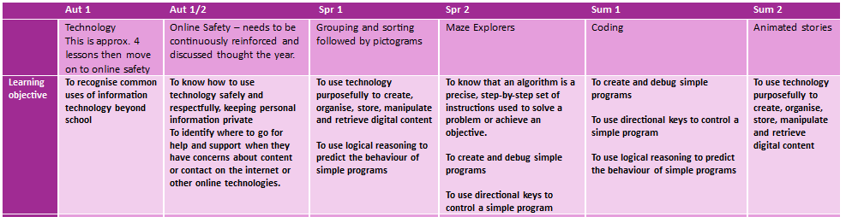
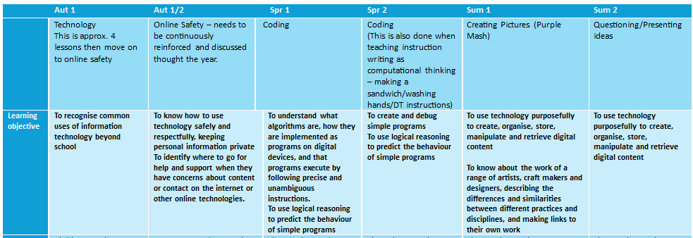
Year 1 & 2 Overview
Intent

Slide 7
Computing
Implementation
Implementation

Slide 8
How do we teach computing?
At Springfield Infant School and Nursery, computing is taught across each year group in modules that enable pupils to study in depth key computing understanding, skills and vocabulary. Each module aims to activate and build upon prior learning, including EYFS, to ensure better cognition and retention. Each module is carefully sequenced to enable pupils to purposefully layer learning from previous sessions to facilitate the acquisition and retention of key computing knowledge. Each module is revisited either later in the year or in the following year as part of a spaced retrieval practice method to ensure pupils retain key knowledge and information.
Implementation

Slide 9
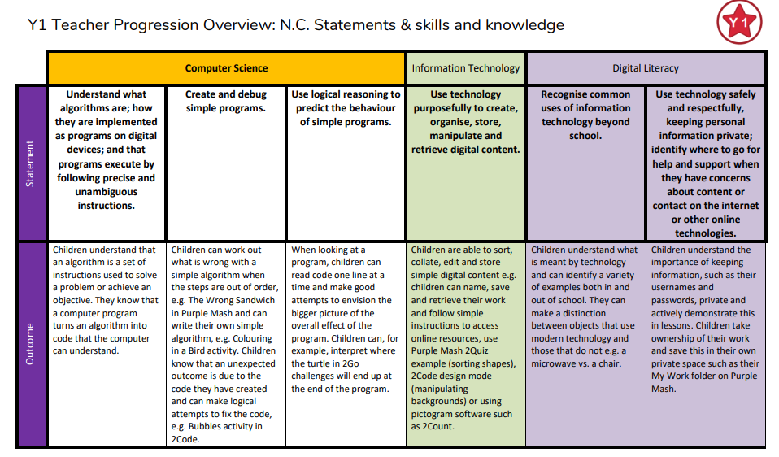
Implementation

Slide 10
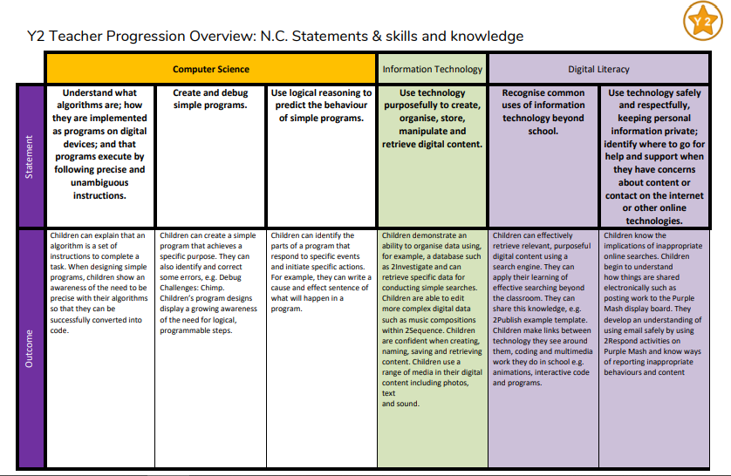
Implementation

Slide 11
Computing
Impact
Impact

Slide 12
Assessment
At the end of each block, teachers assess children’s knowledge and understanding against specific criteria. Knowledge is revisited at the beginning of subsequent lessons through a spaced practice approach to support retention.
Pupil book study
Subject leaders undertake pupil book studies to monitor the effectiveness of teaching and learning. This includes learning impact discussions with small groups of children using questioning to check and ensure vocabulary and knowledge has been learnt and understood. Subject leaders complete a report to inform teaching staff on areas of strength and those requiring improvement. This feedback informs future planning.
Impact

