Slide 1

Design & Technology
Intent
Intent

Slide 2
Design & Technology
At Springfield Infant School and Nursery, we intend for children to become competent and creative problem solvers, inspiring designers and skilled makers. We offer the children a range of opportunities to think creatively as well as acquire skills in order to create. The purpose of teaching D&T is to provide children with an opportunity to practically explore their world and to affect it by creating products to improve it. Children should be taught to use tools competently, accurately and safely in a variety of contexts including textiles, food and materials. Children should learn to evaluate products in the world and also those produced by themselves and their peers. This includes not only what aspects of the designs they like and dislike but also offering improvements.
We want children to leave Springfield as confident and lateral thinkers that are able to problem solve to fulfil the need for this in the wider world and business. The resilience and creativity that is instilled through problem solving are essential skills for a growth mindset.
Intent

Slide 3
Design & Technology
Aims of the Design & Technology Curriculum
The national curriculum for design and technology aims to ensure that all pupils:
develop the creative, technical and practical expertise needed to perform everyday tasks confidently and to participate successfully in an increasingly technological world
build and apply a repertoire of knowledge, understanding and skills in order to design and make high-quality prototypes and products for a wide range of users
critique, evaluate and test their ideas and products and the work of others
understand and apply the principles of nutrition and learn how to cook.
In Key Stage 1, all pupils should be taught and need to understand four key elements of D&T:
Design,
Make,
Evaluate,
Technical knowledge.
Intent

Slide 4
Design & Technology
Early Years
In Early Years, design and technology is taught through Expressive Arts and Design. Our curriculum is designed to provide children with regular opportunities to engage with the arts, use different tools and develop fine motor skills, enabling them to explore and play with a wide range of media and materials. Children are encouraged to do this by:
Exploring different materials, developing their own ideas and deciding how to use them and what to make.
Exploring textures and different ways to join materials.
Working collaboratively to discuss problems and how they might be solved.
Reflecting with children on how they have achieved their aims.
Encouraging children to notice what they can see in the natural world, e.g. shapes, colours and texture.
Intent

Slide 5
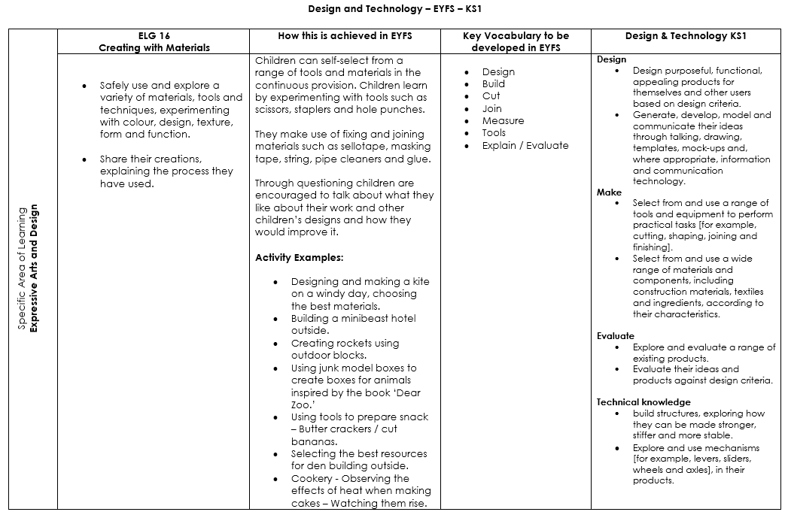
Content and sequence - EYFS to Key Stage 1
Intent

Slide 6
Year 1 & 2 Overview
CUSP D&T Long Term Sequence. | Autumn 1 | Autumn 2 | Spring 1 | Spring 2 | Summer 1 | Summer 2
Year 1 | Mechanisms | Structures | Understanding materials | Textiles | Food and nutrition
Year 2 | Food and nutrition |  | Textiles Mechanisms |  | Structures
Intent

Slide 7
Year 1 & 2 Progression Map
CUSP D&T Long Term Sequence. | Autumn 1 | Autumn 2 | Spring 1 | Spring 2 | Summer 1 | Summer 2
Year 1 | Mechanisms Know common uses of sliders. Know different methods to create card sliders. Know how sliders can create simple mechanisms. Be able to design and make a slider product. Be able to evaluate the success of their outcomes and recommend improvements. | Structures Know a freestanding structure is a structure that stands on its own foundation or base without attachment to anything else. Be able to build structures that are freestanding using a range of different materials. | Understanding materials Know building materials have different properties which enable them to be used for different purposes. Be able to identify, sort and select materials that can be used in construction. Be able to combine materials. | Textiles Know fabric can be joined together using a running stitch. Know the types and names of tools needed for sewing. Be able to create a running stitch, select tools for sewing and thread a needle. | Food and nutrition Know why colourful food can be healthier. Know how different foods can affect senses. Be able to peel, chop and grate a selection of vegetables. Be able to modify food to suit their food senses.
Year 2 | Food and nutrition Know why vegetables are so important to our health. Know what processed foods are. Be able to prepare a range of salad vegetables. Be able to shape and season a bread stick. |  | Textiles Know how to cut out shapes which have been created by using a template. Know how to use a range of basic sewing skills. Be able to use a template to transfer a pattern. Be able to cut out and join fabric shapes using a template. | Mechanisms (Spring 1) Know how wheels and axles work together. Know the size and position of wheels affects how they move. Be able to create a simple wheel mechanism. Be able to use wheel mechanisms to propel a simple vehicle. | Structures Know paper becomes stronger when it is folded. Know a loads is the amount of weight a structure must carry. Be able to fold paper to increase strength and stability. Be able to test and record how much weight paper can hold.
Intent

Slide 8
Design & Technology
Implementation
Implementation

Slide 9
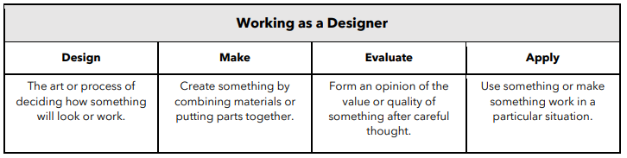
How do we teach design and technology?
At Springfield Infant School and Nursery, design and technology is organised into blocks with each block covering a particular set of disciplines, including food and nutrition, mechanisms and structures. Vertical progression in each discipline has been deliberately woven into the fabric of the curriculum so that pupils revisit key disciplines throughout their journey at Springfield, at increasing degrees of challenge and complexity.
The curriculum also outlines key aspects of development in the Working as a Designer section, with each block focussing on promoting different aspects of these competencies.
Implementation

Slide 10
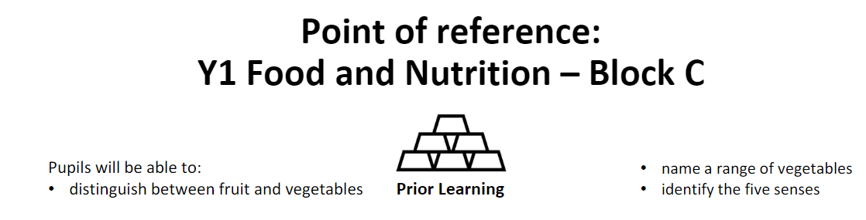
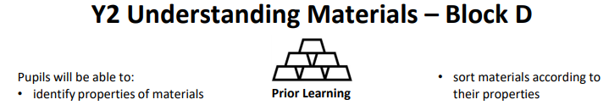
National Curriculum objectives and how these link to prior learning are evident at the beginning of every module.
A Year 1 module showing how the learning builds upon ELGs.​
Implementation
A Year 2 module showing how the learning builds on from prior knowledge in Year 1.

Slide 11
Vocabulary
At Springfield Infants, we want our children to have an expansive vocabulary and through teacher modelling and planning, children are given opportunity to use and apply appropriate vocabulary. Specific, technical vocabulary is taught in each block and children are encouraged to use these terms when discussing their own and others’ work.
CUSP D&T Long Term Sequence. | Autumn 1 | Autumn 2 | Spring 1 | Spring 2 | Summer 1 | Summer 2
Year 1 | Mechanisms Slider Slot Bridge Push Pull Rigid | Structures Tower Topple Lean Foundation Balance Perpendicular | Understanding materials Construction Properties Architect Modify Cement Solidify | Textiles Binca Sewing Felt Running stitch Attach Pouch | Food and nutrition Senses Vitamins Texture Variety Bridge Claw
Year 2 | Food and nutrition Free-range Processed Coagulate Vitamins Protein Wholemeal |  | Textiles Patchwork Overstitch Repurpose Template Applique Quilt | Mechanisms (Spring 1) Wheel Axle Axle holder Chassis Rotate Position Centre | Structures Paper Crease Corrugated Pillar Storey Load
Implementation

Slide 12
Knowledge notes
Accompanying each block is a Knowledge note which contains key vocabulary, information and concepts which all pupils are expected to understand and retain. They support vocabulary and concept acquisition through a well-structured sequence that is cumulative. Each Knowledge note focuses on the key content to be learnt and understood. Knowledge notes are referenced throughout each module and are stuck into DT books.
Implementation

Slide 13
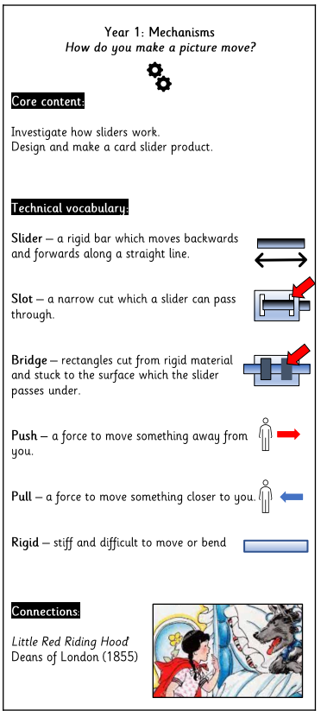
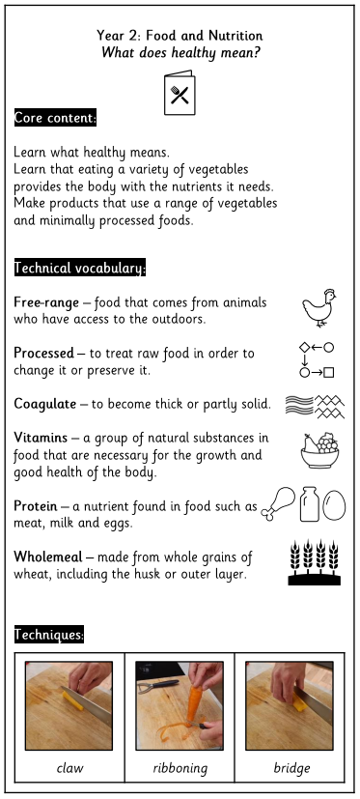
Knowledge note examples
Implementation

Slide 14
Design & Technology
Impact
Impact

Slide 15
Assessment
At the end of each block, teachers assess children’s knowledge and understanding against specific criteria. Knowledge is revisited at the beginning of subsequent lessons through a spaced practice approach to support retention.
Pupil book study
Subject leaders undertake pupil book studies to monitor the effectiveness of teaching and learning. This includes learning impact discussions with small groups of children using questioning to check and ensure vocabulary and knowledge has been learnt and understood. Subject leaders complete a report to inform teaching staff on areas of strength and those requiring improvement. This feedback informs future planning.
Impact

