Slide 1

English
Reading and Writing
Intent
Intent

Slide 2
English
At Springfield Infant and Nursery we work tirelessly to ensure that all pupils have the skills and strategies that enable them to be independent readers and writers, we strive for them to be able to:
Read fluently with good comprehension (both fiction and non-fiction) and to enjoy stories and books for pleasure
Increase and build upon their existing vocabulary across the curriculum in order to use it in their writing, reading and spoken language
Talk clearly and define their ideas confidently
Develop a secure understanding of a sentence writing to then build stamina to write at length, with accurate spelling, grammar and punctuation
Independently compose different genres including; stories, non-chronological reports, poems, letters, diaries, instructions, recounts and descriptions
Intent

Slide 3
English
Aims of the English Curriculum
The national curriculum for English aims to ensure that all pupils:
read easily, fluently and with good understanding
develop the habit of reading widely and often, for pleasure and information
acquire a wide vocabulary, and understanding of grammar knowledge of linguistic conventions for reading, writing and spoken language
appreciate our rich and varied literary heritage
write clearly accurately and coherently, adapting their language and style in and for a range of contexts, purposes and audiences
use discussion in order to learn; they should be able to elaborate and explain clearly their understanding and ideas
are competent in the art of speaking and listening, making formal presentations, demonstrating to others and participating in debate
Intent

Slide 4
English
Aims of the writing Curriculum
Our writing curriculum at Springfield Infant School is designed with a coherent progression of skills across Reception and Key Stage 1.
We are committed to:
Building early language and writing skills through rich, purposeful opportunities that are engaging and relevant to children’s experiences.
Developing phonics knowledge and fine motor skills to support accurate spelling and fluent handwriting.
Encouraging children to express themselves creatively and with confidence, using varied vocabulary and sentence structures.
Embedding reading and writing as interconnected skills, understanding that strong reading underpins effective writing.
Promoting inclusive practices that meet the diverse needs of all learners, ensuring equity of opportunity.
Providing a broad and balanced curriculum that connects writing with real-world contexts, making learning meaningful and purposeful.
Intent

Slide 5
English
Aims of the reading Curriculum
To teach pupils the skills to read confidently with prosody and clear comprehension skills.
To enable children to become independent in their own reading and learning, for them to develop their own interests and choose the types of texts they want to read.
To introduce our young learners to the world of knowledge through texts that provide breadth and variety, both through shared stories and independent reading.
For pupils to develop culturally, emotionally, intellectually, socially and spiritually, through carefully chosen texts.
For competent readers to be able to acquire both new knowledge and to build on what they already know.
To develop the skills to discuss and compare characters, stories and genres
Intent
Notes:
character

Slide 6
English
Reading
Word reading
Prosody and fluency
Comprehension (both listening and reading)
Writing
Transcription (spelling and handwriting)
Composition (articulating ideas and structuring them into speech and writing)
Vocabulary, grammar and punctuation
Intent

Slide 7
English
Early Years
In EYFS at Springfield Infant school we:
Support children from mark-making to forming letters and simple sentences, building fine motor skills alongside writing.
Teach strong phonics integration: systematic phonics (RWI) teaching to help children connect sounds to letters and apply this in their writing.
Provide meaningful contexts: Writing opportunities are linked to children’s interests, play, stories, and real-life experiences.
Allow for creativity and exploration: we encourage children to experiment with marks and express their ideas freely both inside and outside the classroom
Teach explicit skills in letter formation, sentence structure, and punctuation, balanced with play-based learning.
Maintain an inclusive and supportive learning environment with differentiated approaches to meet the needs of all learners, including SEND and EAL children.
English-rich environment allowing the children to access writing materials, inspiration and support writing throughout the setting.
Intent

Slide 8
English
Early Years
In Early Years, English is taught firstly through dedicated systematic synthetic phonics sessions and interleaved the curriculum. Each carefully designed session is created to provide children with the regular opportunities needed to practise their literacy skills:
Read, Write Inc daily phonics session
Shared reading to build listening skills, vocabulary and comprehension
Story scripts and ‘active story-telling’ help build oracy skills and allows the children to try out the new vocabulary they are being taught.
Role play with specific themes to support vocabulary
Fine motor sessions to strengthen hands and improve pencil control
Handwriting sessions focus on name writing, letter and number formation.
Opportunities to read, mark make and write across the curriculum
Intent

Slide 9
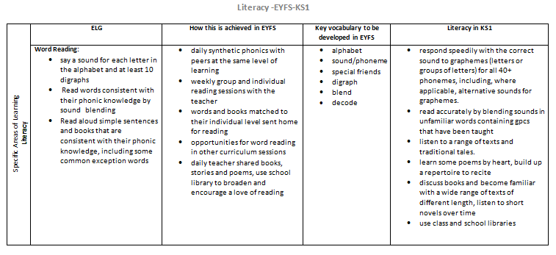
Content and Sequence - Word Reading- EYFS to Key Stage 1
Intent

Slide 10
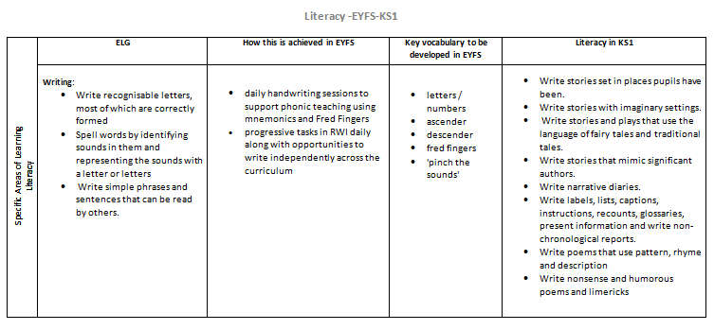
Content and Sequence - Writing - EYFS to Key Stage 1
Intent

Slide 11
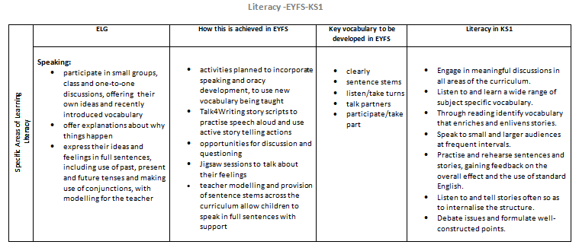
Content and Sequence - Speaking - EYFS to Key Stage 1
Intent

Slide 12
Reading and Writing
At Springfield Infants we know there is a symbiotic relationship between reading and writing, and that this reciprocal relationship also heavily relies on oral language and vocabulary. To help us deliver targeted support for all learners we follow Read Write Inc consistently throughout Reception, Year 1 and into the start of Year 2. Our aim is to ensure all children develop their reading ability from their own starting point, with the intention of all children ultimately becoming competent readers, who can enjoy a range of texts for pleasure and as a source of learning.
Reading:
The skills for ‘Paired Reading’ continues into whole class sessions in KS1. High quality stories and targeted questioning support the wider development and enjoyment of reading texts in sessions supported by the teacher.
Each year group have targeted skills to develop:
EYFS: decoding
Year 1: consolidation of reading graphemes, phonics screening preparation and fluency
Year 2: Prosody and comprehension
Intent

Slide 13
Writing
At Springfield Infant School, our writing curriculum is thoughtfully designed to engage and develop every child’s writing ability from EYFS through to Year 2. We provide daily handwriting and fine motor skill activities to build the physical foundations of writing. Our bespoke curriculum is exciting and linked closely to other curriculum areas, ensuring writing is meaningful and relevant.
We follow a carefully structured progression that explicitly develops key skills, including spelling, grammar, and punctuation. Children experience a wide range of rich texts that inspire and support their writing across diverse genres.
Our teaching balances short burst writing tasks to develop fluency and confidence, with longer, purposeful writing opportunities that encourage creativity and deeper learning. This approach ensures children build a secure foundation in writing, preparing them to become confident and independent writers by the end of Key Stage 1.
Intent

Slide 14
English
Implementation
Implementation

Slide 15
Reading:
Our reading is taught with fidelity and consistency using the ‘Read, Write Inc’ programme. All staff are trained and equipped to teach RWI in all the year groups, this means that teachers are adept at helping young learners progress along their reading journey. Children are assessed regularly throughout the year and grouped according to their level of need. The skills that the children have learned in decoding and word reading through the EYFS are later supported through whole reading class sessions in KS1. High quality stories and targeted questioning support the wider development and enjoyment of reading texts in sessions supported by the teacher.
Implementation

Slide 16
Writing:
We implement our writing curriculum through a carefully sequenced and engaging approach that ensures clear progression from EYFS to Year 2.
Our bespoke curriculum is delivered daily, embedding handwriting and fine motor skill development to build essential physical foundations.
We use a rich range of carefully selected texts linked to other curriculum areas to inspire purposeful writing across a variety of genres. Teaching balances short burst writing tasks that build fluency with longer, meaningful writing opportunities to develop creativity and stamina.
Grammar, punctuation, and spelling are explicitly taught and revisited regularly, ensuring children acquire and apply these skills confidently over time.
Our curriculum is inclusive and differentiated, ensuring all children, including those with additional needs, access appropriate challenge and support.
Ongoing assessment is embedded in daily teaching, enabling teachers to identify individual needs, adapt in real time, inform planning and provide constructive feedback that supports children’s confidence and continuous improvement in writing.
Implementation

Slide 17
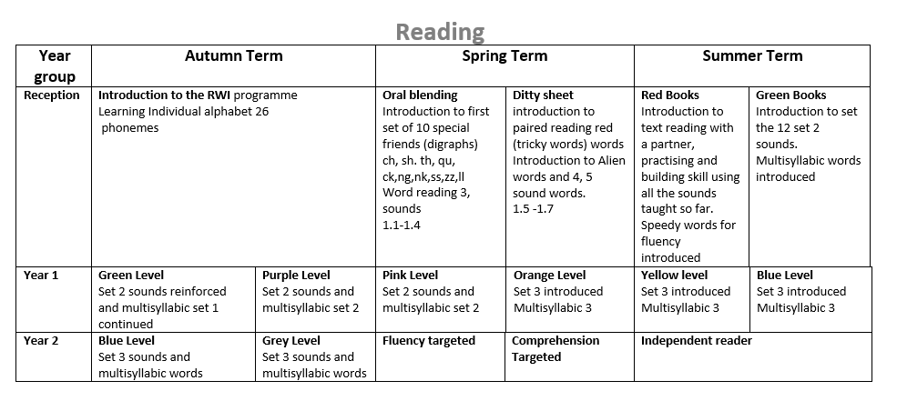
EYFS through to KS1 reading progression
Implementation

Slide 18
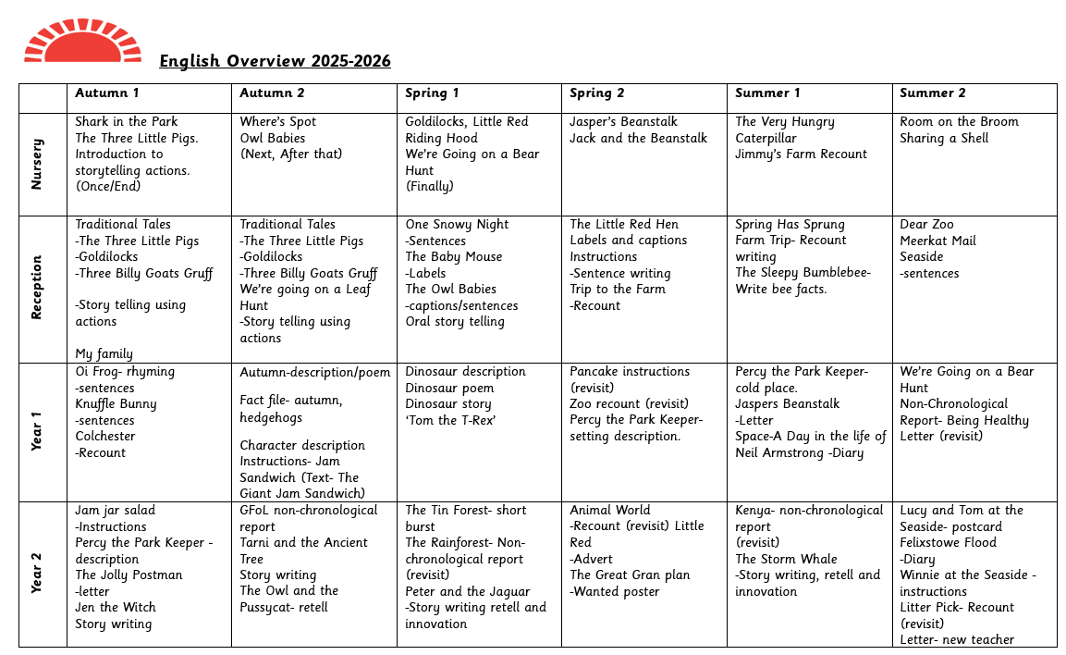
EYFS through to KS1 writing progression
Implementation

Slide 19
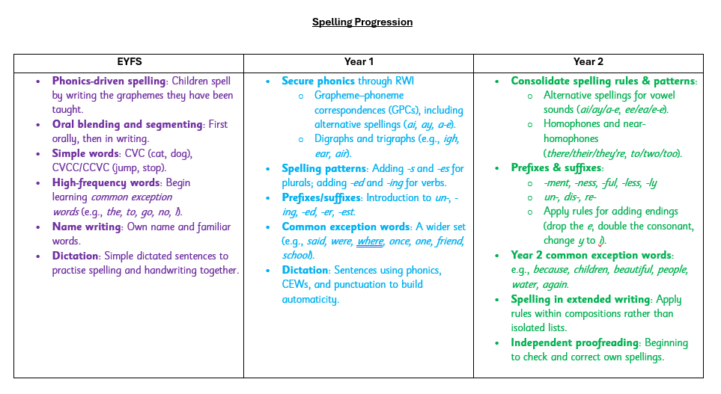
EYFS through to KS1 writing progression
Implementation

Slide 20
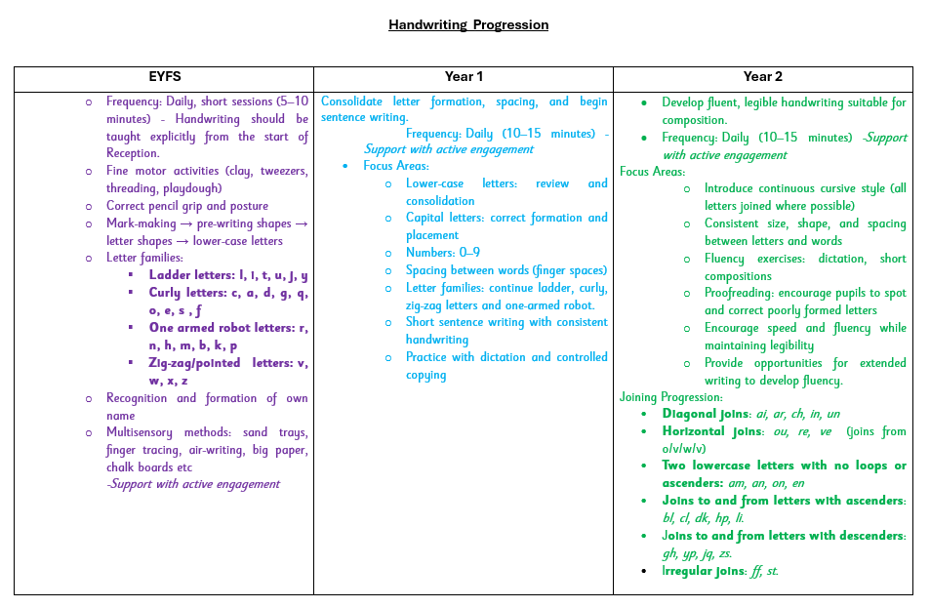
EYFS through to KS1 writing progression
Implementation

Slide 21
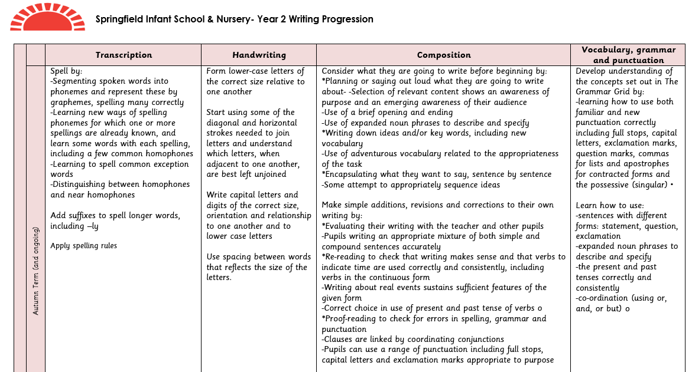
EYFS through to KS1 writing progression
Implementation

Slide 22
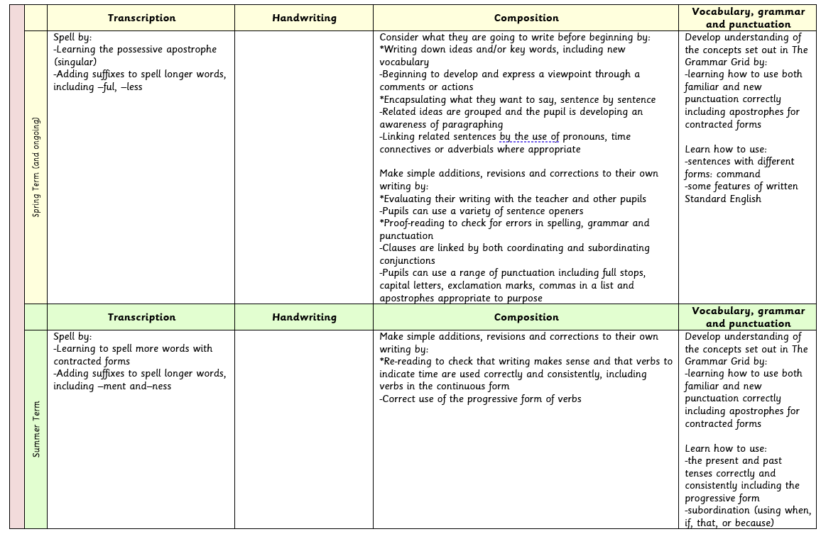
EYFS through to KS1 writing progression
Implementation

Slide 23
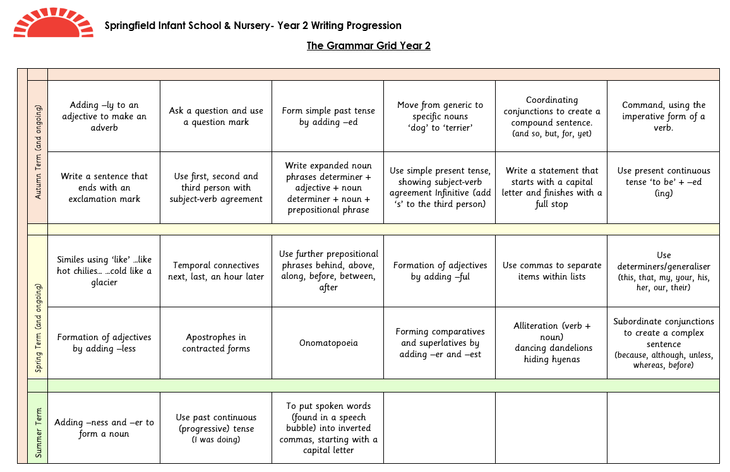
EYFS through to KS1 writing progression
Implementation

Slide 24
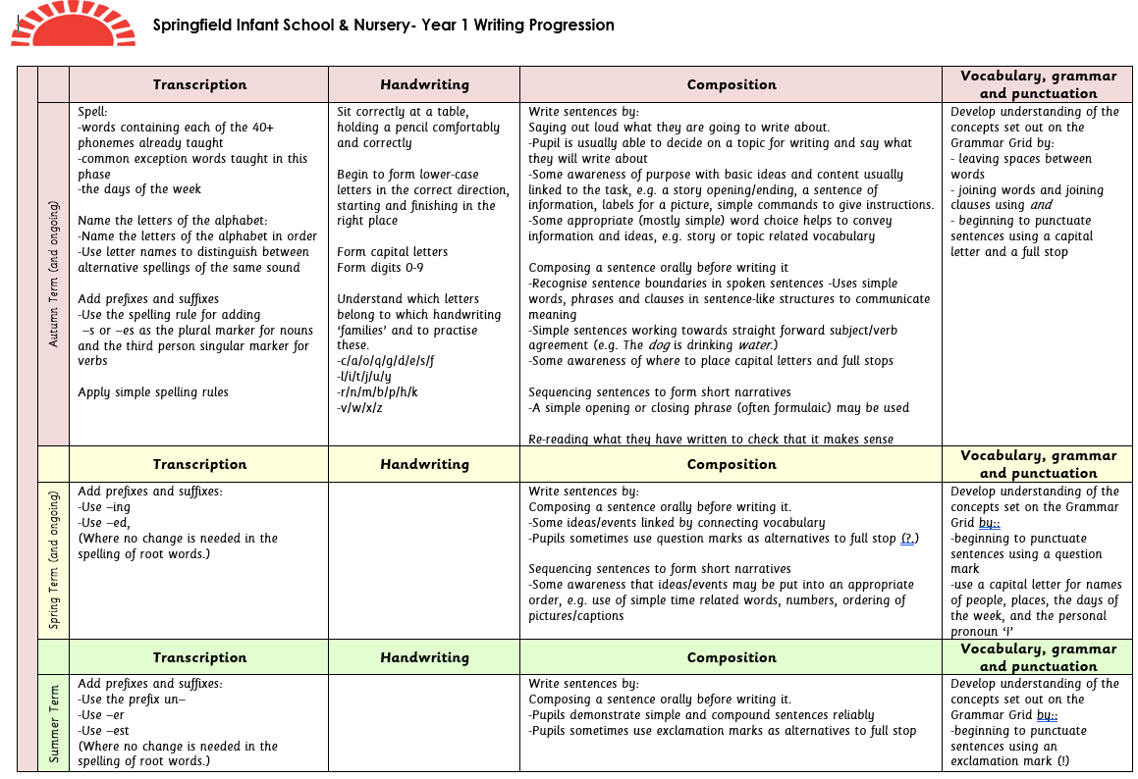
EYFS through to KS1 writing progression
Implementation

Slide 25
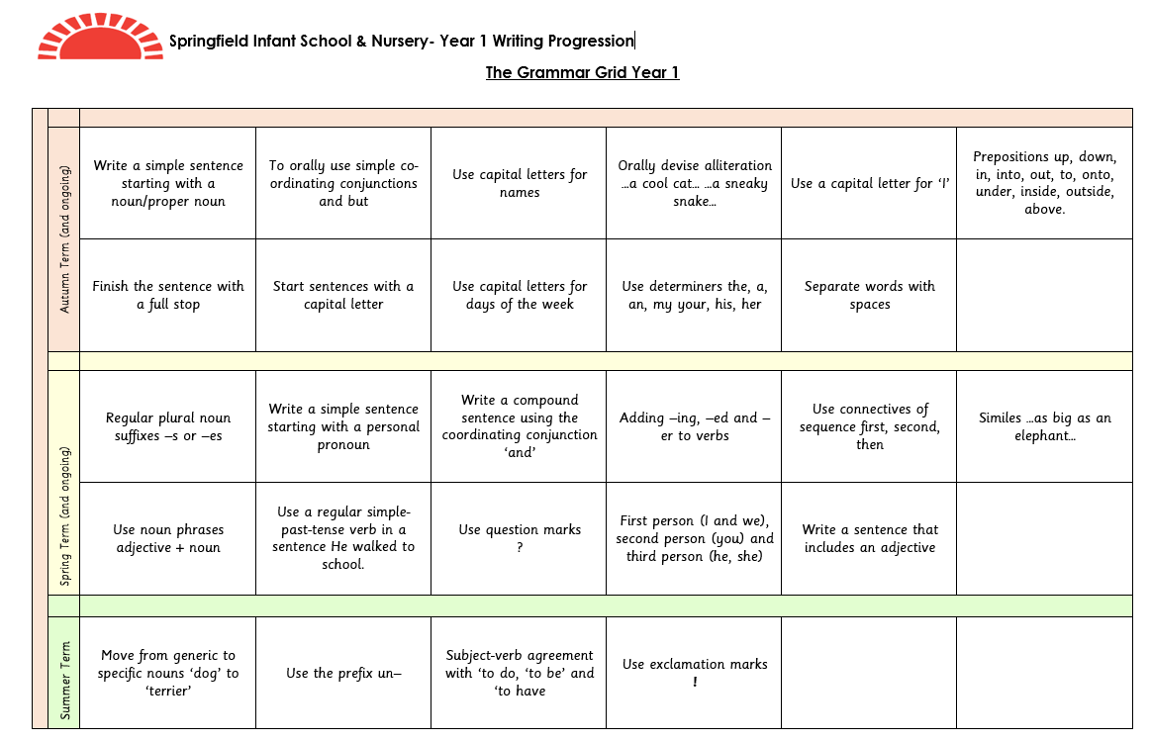
EYFS through to KS1 writing progression
Implementation

Slide 26
English
Impact
Impact

Slide 27
Assessment- Reading
Reading for all pupils is assessed at six weekly intervals by the reading lead. Every child starts their RWI formal assessment in the first term they start school. The same document follows them through until they reach year 2 and complete the Read, Write Inc programme. The children are grouped according to their assessment outcomes and afternoon reading interventions are targeted at different children, depending on individual needs. In year 2, the children are assessed through teacher assessment and in the Spring term children complete a practice SAT paper. These assessments in year 2 help us to target further individual support for reading, either decoding and phonics, fluency or comprehension. Children in year 2 that are still at the early stages of reading continue to work in RWI groups to support their learning.
Impact

Slide 28
Assessment- Writing
At Springfield assessment in writing from EYFS to Key Stage 1 is an integral part of teaching and learning, designed to support every child’s progress and inform responsive planning.
In EYFS, assessment is primarily formative and observational. Teachers use continuous observation and evidence gathering during play and focused activities to assess children’s emergent writing skills, including mark-making, letter formation, and early phonetic attempts. Assessment is linked closely to the Early Learning Goals for Literacy, tracking children’s development in communication, language, and writing. This approach helps identify individual strengths and areas needing support early, enabling tailored interventions.
As children progress into Year 1 and Year 2, assessment becomes more formalised while maintaining a formative focus. Teachers regularly use a range of assessment strategies, including:
Daily formative assessments during writing tasks to monitor application of phonics, handwriting, grammar, punctuation, transcription and composition skills.
Use of short burst and extended writing samples to assess fluency, creativity, and application of taught skills across different genres.
Marking and constructive feedback that encourages self-reflection and improvements, fostering children’s confidence and independence as writers.
Half termly the children complete an unaided piece of writing which teachers will assess against ‘Age Related criteria grids. Teachers gather evidence to track progress against age-related standards and inform future planning. The teachers also complete a Common Exception Word check.
Our year groups, whole school and OMAT moderation processes to ensure consistency and accuracy.
This comprehensive assessment approach allows teachers to adapt planning and interventions, ensuring children make progress in writing and are well-prepared for the demands of Key Stage 2.
Impact

Slide 29
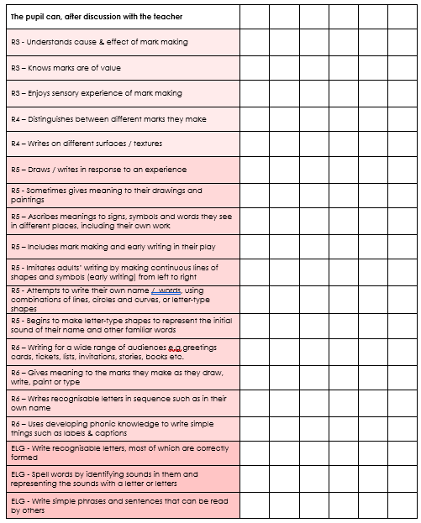
Assessment- EYFS
Impact

Slide 30
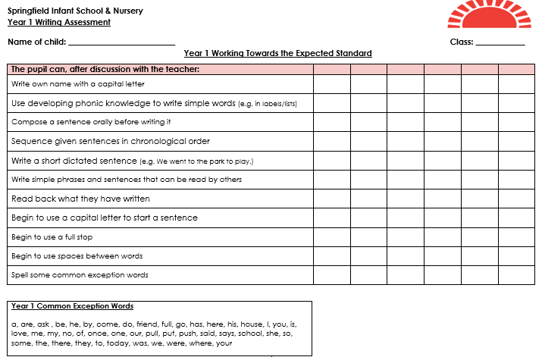
Assessment- Year 1
Impact

Slide 31
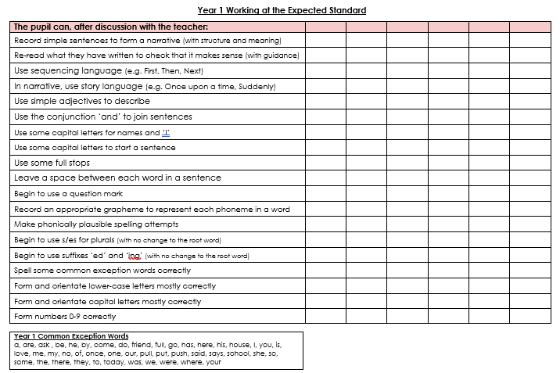
Assessment- Year 1
Impact

Slide 32
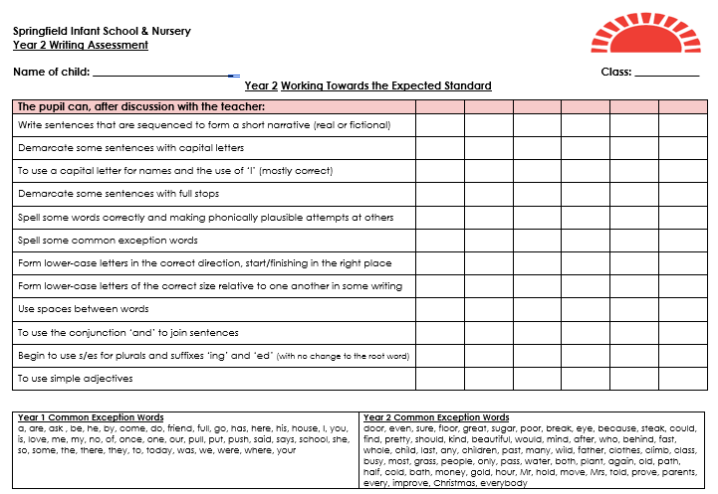
Assessment- Year 2
Impact

Slide 33
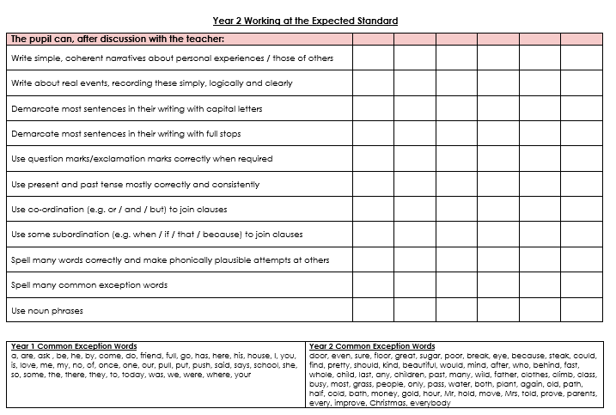
Assessment- Year 2
Impact

Slide 34
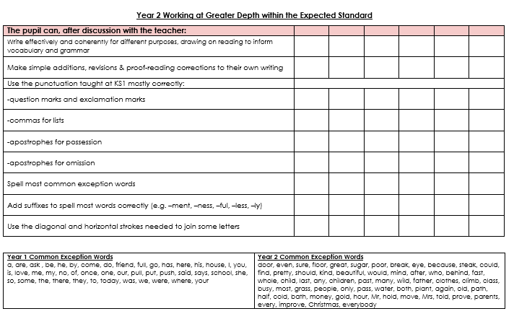
Assessment- Year 2
Impact

Slide 35
Development and Training for Staff
All staff who teach RWI are formally observed by the reading lead and assistant lead each term. Training and support comes from both external training and through the reading lead. Lesson plans have been created for whole class reading books and high-quality engaging texts have been purposely chosen for teacher led sessions. Support for teacher assessment comes from running records and RWI assessments for both decoding and fluency. Reading development days with RWI trainers and access to the online portal are among the on-going support staff receive.
Impact

Slide 36
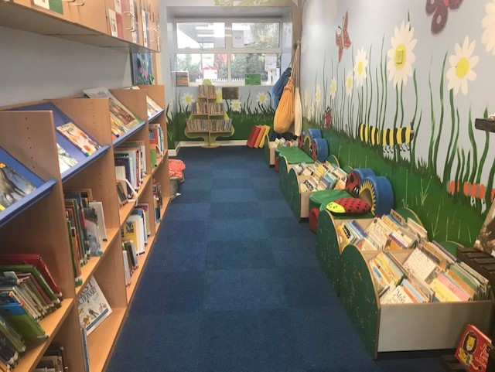
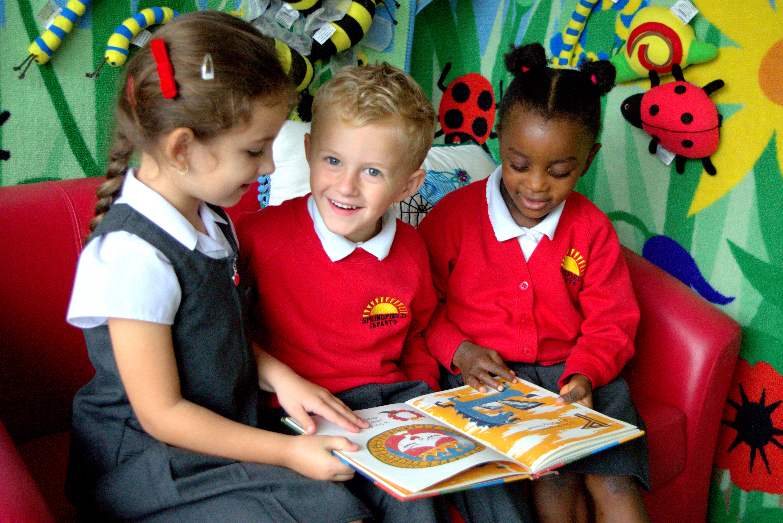
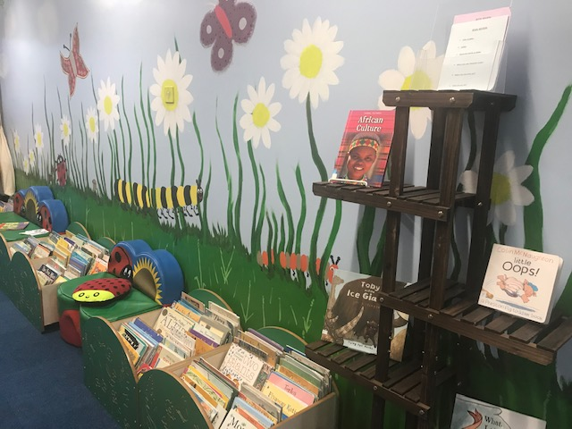
Impact
July 25 | EXS | GDS
Reading | 70% | 14%

