Slide 1

History
Intent
Intent

Slide 2
History
It is our intent that all children will understand what it is to be a 'historian'. For our children this will mean learning about history, how the world has changed and significant people in history. We will ensure children are given the opportunities and practical experiences to learn about those people and how the world has changed in their locality and the wider world. History will be taught with a keen focus on developing a secure knowledge of their own and their family’s history; history of their own local area and of the United Kingdom and significant people in UK history. Opportunities will be given to develop a range of historical skills, including how to use historical texts and artefacts alongside fieldwork and observational experiences. Through specific teaching of subject specific terminology we aim to provide the children with a core vocabulary to use. This will provide them with the skills and confidence to express themselves and to communicate their ideas clearly, using historical terms.
Intent

Slide 3
History
Aims of the History Curriculum
The national curriculum for History aims to ensure that all pupils:
know and understand the history of these islands as a coherent, chronological narrative, from the earliest times to the present day: how people’s lives have shaped this nation and how Britain has influenced and been influenced by the wider world.
know and understand significant aspects of the history of the wider world: the nature of ancient civilisations; the expansion and dissolution of empires; characteristic features of past non-European societies; achievements and follies of mankind.
gain and deploy a historically grounded understanding of abstract terms such as ‘empire’, ‘civilisation’, ‘parliament’ and ‘peasantry’.
understand historical concepts such as continuity and change, cause and consequence, similarity, difference and significance, and use them to make connections, draw contrasts, analyse trends, frame historically-valid questions and create their own structured accounts, including written narratives and analyses.
understand the methods of historical enquiry, including how evidence is used rigorously to make historical claims, and discern how and why contrasting arguments and interpretations of the past have been constructed.
gain historical perspective by placing their growing knowledge into different contexts, understanding the connections between local, regional, national and international history; between cultural, economic, military, political, religious and social history; and between short- and long-term timescales.
Intent

Slide 4
History
Aims of the History Curriculum
Pupils should be taught about:
Changes within living memory – where appropriate, these should be used to reveal aspects of change in national life
Events beyond living memory that are significant nationally or globally [for example, the Great Fire of London, the first aeroplane flight or events commemorated through festivals or anniversaries]
The lives of significant individuals in the past who have contributed to national and international achievements, some should be used to compare aspects of life in different periods [for example, Elizabeth I and Queen Victoria, Christopher Columbus and Neil Armstrong, William Caxton and Tim Berners-Lee, Pieter Bruegel the Elder and LS Lowry, Rosa Parks and Emily Davison, Mary Seacole and/or Florence Nightingale and Edith Cavell]
Significant historical events, people and places in their own locality
Intent

Slide 5
History
Early Years
In Early Years, History is taught through Understanding the world: People and communities. Our curriculum is designed to provide children with regular opportunities to talk about the lives of the people around them and their roles in society, know some similarities and differences between things in the past and now and understand the past through settings, characters and events encountered in books read in class and storytelling. Children are encouraged to do this by:​
Talking about past and present events in their own life and in the lives of family members
Provide role-play areas with a variety of resources
Share stories that reflect past and present
Intent

Slide 6
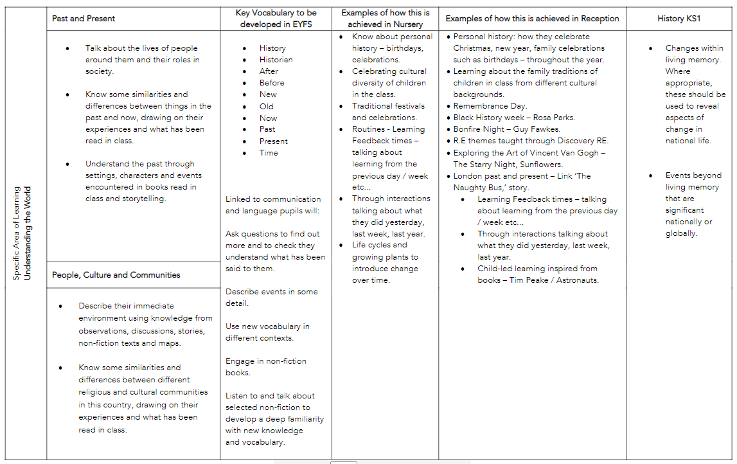
Content and sequence - EYFS to Key Stage 1
Intent

Slide 7
Spaced Retrieval Practice Approach
Our History curriculum is delivered through a series of modules which are deliberately spaced throughout the academic year with opportunities to introduce and revisit key concepts. This approach enables staff to deepen pupil understanding and embed learning.
Our curriculum maps clearly show how our CUSP curriculum delivers (introduces and revisits) the National Curriculum expectations for History within and across year groups.
Intent

Slide 8
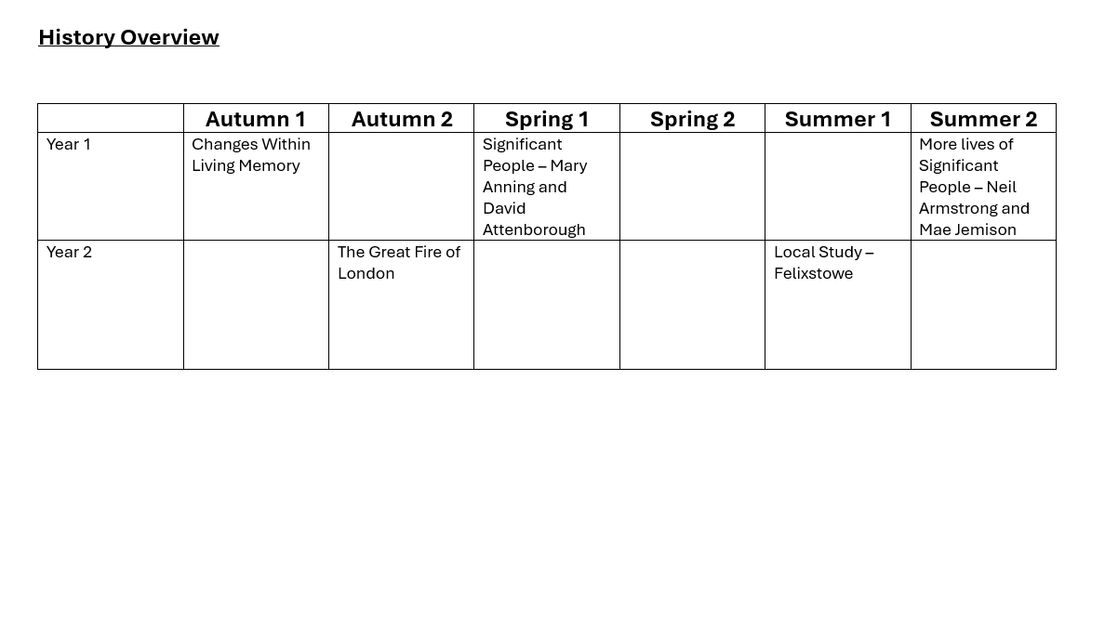
Year 1 & 2 Overview
Intent

Slide 9
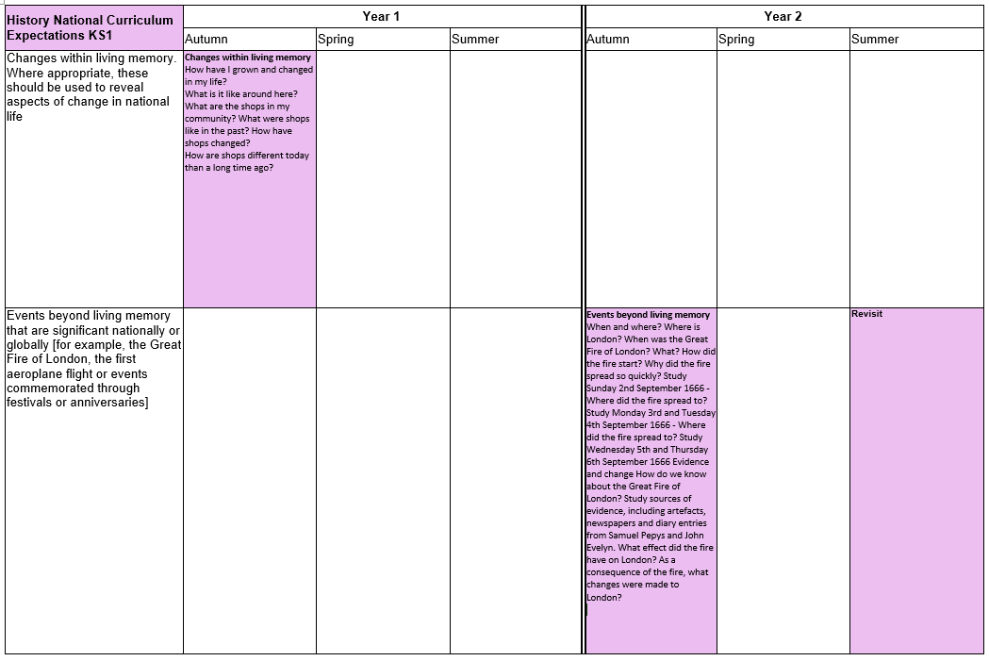
Year 1 & 2 Progression Map
Changes within living memory
How have I grown and changed in my life?
How have the toys I played with changed since I was a baby?
What toys did my grandparents play with?
How are they similar or different to the toys we play with now?
Intent

Slide 10
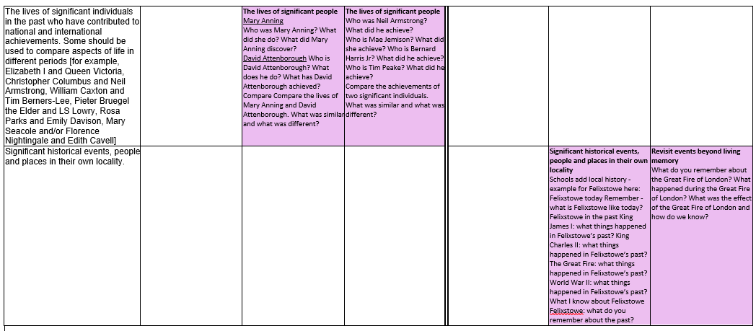
Year 1 & 2 Progression Map
Intent

Slide 11
History
Implementation
Implementation

Slide 12
How do we teach History?
At Springfield Infant School and Nursery, History is taught across each year group in modules that enable pupils to study in depth key historic understanding, skills and vocabulary. Each module aims to activate and build upon prior learning, including EYFS, to ensure better cognition and retention. Each module is carefully sequenced to enable pupils to purposefully layer learning from previous sessions to facilitate the acquisition and retention of key historic knowledge. Each module is revisited either later in the year or in the following year as part of a spaced retrieval practice method to ensure pupils retain key knowledge and information.
Implementation

Slide 13
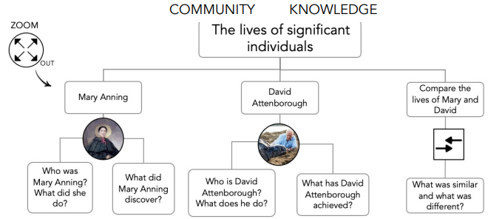
The Big Ideas
At Springfield Infant School, we put an emphasis on sharing the big ideas with the children at the beginning of every module.
Implementation

Slide 14
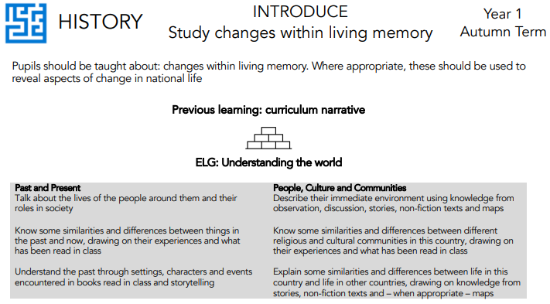
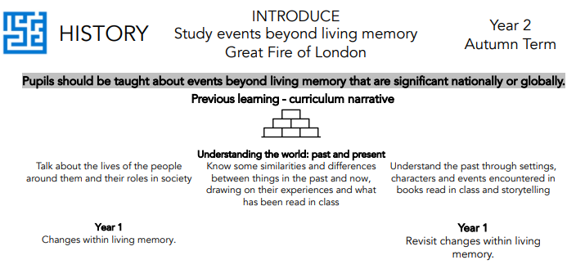
National Curriculum objectives and how these links to prior learning are evident at the beginning of every module.
A Year 1 module showing how the learning builds upon ELGs.
Implementation
A Year 2 module building on prior learning from Year 1.

Slide 15
Knowledge organisers and Knowledge Notes
Accompanying each module is a Knowledge Organiser which contains key vocabulary, information and concepts which all pupils are expected to understand and retain. Knowledge notes are the elaboration and detail which help pupils acquire the content of each module. They support vocabulary and concept acquisition through a well-structured sequence that is cumulative. Each Knowledge Note begins with questions, focussing on key content to be learnt and understood. Knowledge Organisers and Knowledge Notes are dual coded to provide pupils with visual calls to aid understanding and recall. Knowledge Organisers and Knowledge Notes are referenced throughout each module.
Implementation

Slide 16
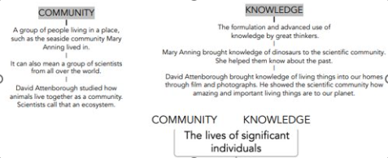
Substantive Knowledge
The knowledge organiser outlines the minimum substantive knowledge expectations, this is the subject knowledge and explicit vocabulary used about the past.​
The substantive concepts are the vehicle to connect substantive knowledge. ​
In History they are:​
Community​
Knowledge​
Power​
Democracy
Implementation

Slide 17
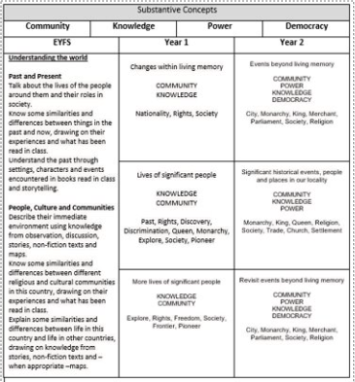
Substantive Concepts
Implementation

Slide 18
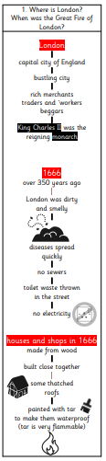
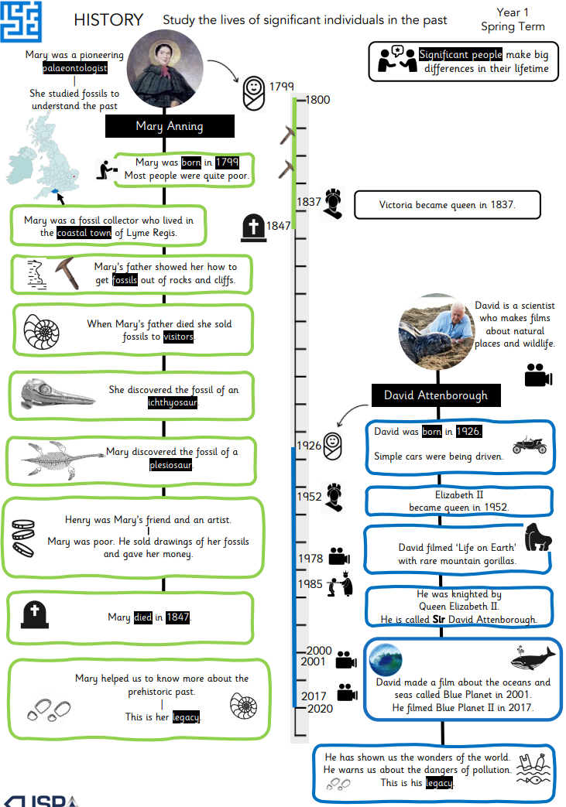
Knowledge organisers and Knowledge Notes
Year 1
Knowledge Organiser
Implementation
Accompanying Year 2 Knowledge Note

Slide 19
History
Impact
Impact

Slide 20
Assessment
At the end of each block, teachers assess children’s knowledge and understanding against specific criteria. Knowledge is revisited at the beginning of subsequent lessons through a spaced practice approach to support retention.
Pupil book study
Subject leaders undertake pupil book studies to monitor the effectiveness of teaching and learning. This includes learning impact discussions with small groups of children using questioning to check and ensure vocabulary and knowledge has been learnt and understood. Subject leaders complete a report to inform teaching staff on areas of strength and those requiring improvement. This feedback informs future planning.
Impact

