Slide 1

PSHE and RSE
Intent
Intent

Slide 2
PSHE and RSE
Here, at Springfield Infant School & Nursery we value PSHE as one way to support children’s development as human beings, to enable them to understand and respect who they are, to empower them with a voice and to equip them for life and learning. We want the subjects to put in place the key building blocks of healthy, respectful relationships, focusing on family and friendships, in all contexts, including online. This will sit alongside the essential understanding of how to be healthy.
To ensure progression and a spiral curriculum, we use Jigsaw, the mindful approach to PSHE, as our chosen teaching and learning programme and tailor it to our children’s needs. This runs alongside our ‘Learning Buddies’ who underpin our vision for who we want our children to be and enable the growth of skills, attitudes and behaviours to support both academic and personal growth.
Intent

Slide 3
PSHE and RSE
Aims of the PSHE and RSE Curriculum
It is a statutory requirement that all primary age children are taught:
Relationships education
Health education and
Sex education that is age appropriate
We aim that through the explicit teaching of our Jigsaw PSHE scheme it will develop the spiritual, moral, social, cultural, and mental development of our pupils.
Our children will aim high by promoting a positive mindset which builds confidence, supports independence and increases resilience so that our children have the skills to achieve later in life and become responsible citizens.
It will help to safeguard children through the explicit teaching of healthy relationships and sex education.
Intent

Slide 4
PSHE and RSE
Jigsaw PSHE 3-11.
Jigsaw holds children at its heart, and its cohesive vision helps children understand and value how they fit into and contribute to the world. With strong emphasis on emotional literacy, building resilience and nurturing mental and physical health, Jigsaw properly equips schools to deliver engaging and relevant PSHE within a whole school approach. Jigsaw lessons also include mindfulness allowing children to advance their emotional awareness, concentration, focus and self regulation.
Intent

Slide 5
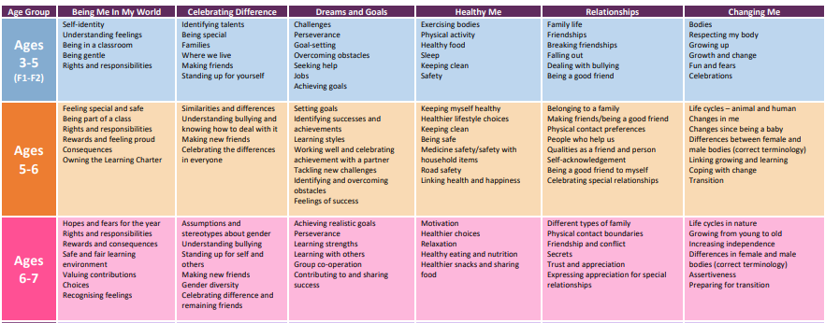
Content and sequence - EYFS to Key Stage 1
Intent

Slide 6
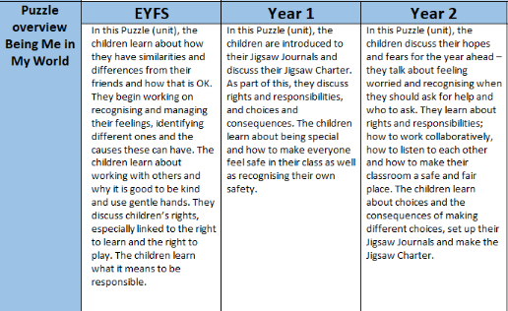
EYFS, Year 1 & 2 Progression Map
Intent

Slide 7
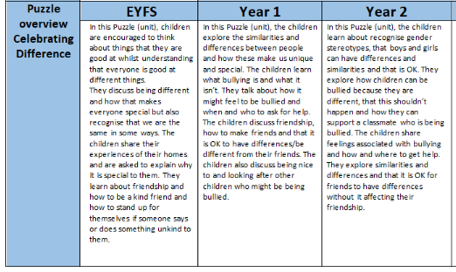
EYFS, Year 1 & 2 Progression Map
Intent

Slide 8
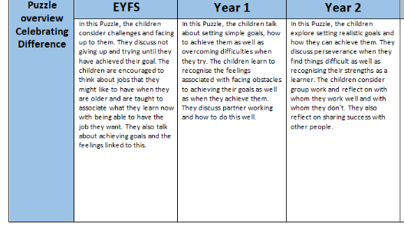
EYFS, Year 1 & 2 Progression Map
Intent

Slide 9
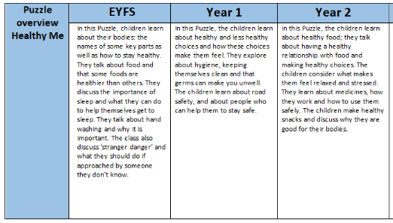
EYFS, Year 1 & 2 Progression Map
Intent

Slide 10
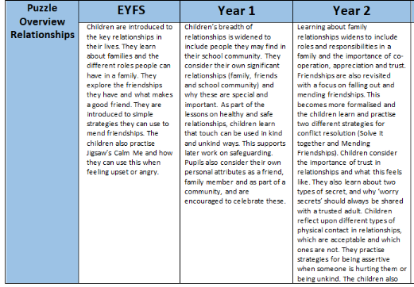
EYFS, Year 1 & 2 Progression Map
Intent

Slide 11
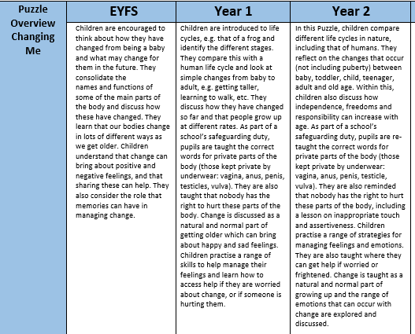
EYFS, Year 1 & 2 Progression Map
Intent

Slide 12
PSHE and RSE
Implementation
Implementation

Slide 13
How do we teach PSHE and RSE?
At Springfield Infant School and Nursery, PSHE and RSE is taught across each year group through the programme called Jigsaw. Jigsaw is taught as 6 puzzle pieces that cover ‘Being Me in My World', ‘Celebrating Difference', ‘Dreams and Goals', ‘Healthy Me', ‘ Relationships' and ‘Changing Me'. Each puzzle piece focuses on a specific area relating to the PSHE or RSE statutory guidance. In reception, children complete circle time activities and in year 1 and 2 there is a mixture of circle time activities and directed tasks. There is a Jigsaw Charter that teaches the rules of Jigsaw sessions and links to British Values, which is referred back to throughout the year. At the beginning of every afternoon, all children have ‘calm me time’ using the Jigsaw approach.
Implementation

Slide 14
PSHE and RSE
Impact
Impact

Slide 15
Pupil book study
Subject leaders undertake pupil book studies to monitor the effectiveness of teaching and learning. This includes learning impact discussions with small groups of children using questioning to check and ensure vocabulary and knowledge has been learnt and understood. Subject leaders complete a report to inform teaching staff on areas of strength and those requiring improvement. This feedback informs future planning.
Impact

