Slide 1

Art & Design
Intent
Intent

Slide 2
Art & Design
Aims of the Art & Design Curriculum:
At Springfield Infant School and Nursery, we intend for children to become expressive, free and imaginative when using a wide variety of media. Throughout their time at Springfield, we should provide them with a range of experiences, as well as the skills necessary, to enable them to express themselves creatively. The purpose of teaching art is to provide children with an opportunity to communicate their self-reflection externally, as many children often cannot find the words to express how they are feeling and/or their opinion on a subject – through arts, we may enable them to show this through the use of a variety of artistic skills.
Children should learn to appreciate and critique their own, their peers’ and examples of art from around the world, including artwork from a variety of cultures, both past and present. They should recognise that art is not only created by ‘famous artists,’ but that it is a communication tool in the skill repertoire of designers, book illustrators, architects, film makers etc.
Intent

Slide 3
Art & Design
Aims of the Art & Design Curriculum
The national curriculum for Art & Design aims to ensure that all pupils:
Produce creative work, exploring their ideas and recording their experiences
Become proficient in drawing, painting, sculpture and other art, craft and design technqiues
Evaluate and analyse creative works using the language of art, craft and design
Know about great artists, craft makers and designers, and understand the historical and cultural development of their art forms.
Intent

Slide 4
Art & Design
Early Years
In Early Years, Art is taught through Expressive Arts and Design. Our curriculum is designed to provide children with regular opportunities to engage with the arts, enabling them to explore and play with a wide range of media and materials. Children are encouraged to do this by:
Exploring colours and how colours can be changed through combining and mixing
Using drawing to represent actions and objects based on imagination, observation and experience
Using everyday materials to explore, understand and represent their world – their ideas, interests and fascinations
Using tools for purpose, as well as showing increased control in holding, using and manipulating these tools, including paintbrushes, scissors etc.
Exploring different materials freely, developing their own ideas and deciding how to use them
Creating collaboratively, sharing ideas, resources and skills.
Intent

Slide 5
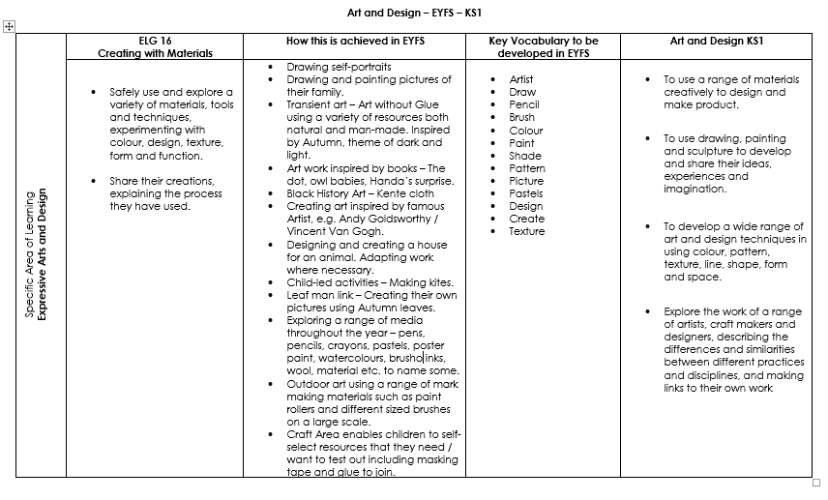
Content and sequence - EYFS to Key Stage 1
Intent

Slide 6
Spaced Retrieval Practice Approach
Our Art & Design curriculum is delivered through a series of modules which are deliberately spaced throughout the academic year with opportunities to introduce and revisit key concepts. This approach enables staff to deepen pupil understanding and embed learning.
Our curriculum maps clearly show how our CUSP curriculum delivers (introduces and revisits) the National Curriculum expectations for Art & Design within and across year groups.
Intent

Slide 7
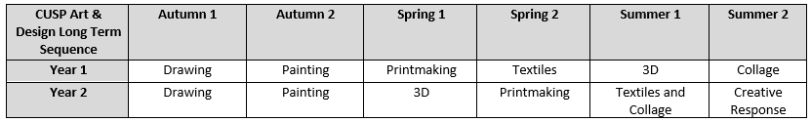
Year 1 & 2 Overview
Intent

Slide 8
Year 1 & 2 Progression Map
Art National Curriculum Expectations KS1 | Year 1 |  |  | Year 2
 | Autumn | Spring | Summer | Autumn | Spring | Summer
To use a range of materials creatively to design and make products | Drawing – creating texture | Print making – block printing and clay slabs. Textiles – weaving, fabric dying. | 3D – natural and man-made materials. Collage – creating texture. | Drawing – creating texture, using a range of media to create effect on textures. | 3D – joining/molding materials Print-making – make collograph printing blocks | Textiles & Collage – dip dye, relief and block printing, creating texture
To use drawing, painting and sculpture to develop and share their ideas, experiences and imagination | Drawing | Printmaking | 3D | Drawing | 3D | Textiles and collage
 | Painting | Textiles | Collage | Painting | Printmaking
To develop a wide range of art and design techniques in using colour, pattern, texture, line, shape, form and space | Drawing – mark making , line drawing Painting – identify primary colours, make thick and thin marks. | Printmaking – controlled brushstrokes and stippling, relief printing. Textiles – begin to use mixed media, combine materials. | 3D – self-select materials based on their properties. Collage – tear/cut paper for effect, build layers for texture. | Drawing – mark making, line drawing Painting – use colour to show mood/movement, secondary colours and mixing | 3D – joining materials, making small models Printmaking – create repeating patterns, combine printing techniques | Textiles & Collage – pattern, line and colour using mixed media, select appropriate images, colour and textures to create new art
About the work of a range of artists, craft makers and designers, describing the differences and similarities between different practices and disciplines, and making links to their own work. | Drawing - The Rhinocerosby Albrecht Durer (1515) Painting - Composition II in Red, Blue and Yellow by Piet Mondrian (1930) | Printmaking – Karent Lederer (Contemporary Artist) Textiles – Anne Kelly (Contemporary Artist) | 3D – Kenojuak Ashevak Collage – Paul Klee | Drawing – Waves by Beth Krommes (2021) Painting - Composition VII by Wassily Kandinsky (1913) | 3D – Katie Vernon (Contemporary Mixed Media Artist) Printmaking – William Morris | Textiles & Collage – John Kindness
Intent
Colours indicate | Main content | Connected skill or vocabulary

Slide 9
Art & Design
Implementation
Implementation

Slide 10
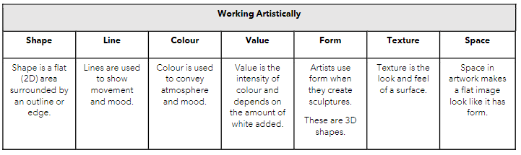
How do we teach Art & Design?
At Springfield Infant School and Nursery, art is organised into blocks covering a particular set of artistic disciplines, including drawing, painting, printmaking, textiles, 3D and collage. Vertical progression in each discipline has been deliberately woven into the curriculum so that children revisit key disciplines throughout KS1 at increasing degrees of challenge and complexity.
In addition to this core knowledge, the curriculum outlines key aspects of artistic development. Each module focuses on developing different aspects of these competencies.
Implementation

Slide 11
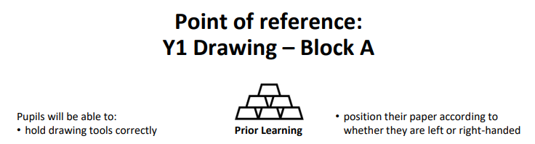
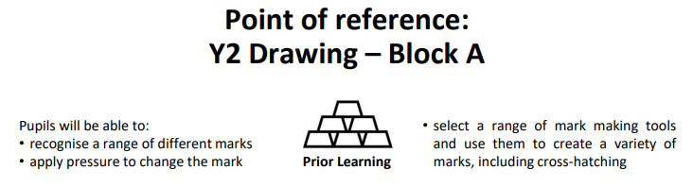
National Curriculum objectives and how these links to prior learning are evident at the beginning of every module.
A Year 1 module showing how the learning builds upon ELGs.
Implementation
A Year 2 module building on prior learning of drawing from Year 1.

Slide 12
Knowledge organisers and Knowledge Notes
Accompanying each module is an ‘Overview of Block Contents’ which contains key skills and techniques covered in the lessons included. The Overview of Block Contents also lists the expected outcomes, the artistic knowledge and skills that pupils will have been expected to acquire by the end of the block. Knowledge Notes are the elaboration and detail which help pupils acquire the content of each module. They support vocabulary and concept acquisition through a well-structured sequence that is cumulative. Each Knowledge Note focuses on the key content to be learnt and understood. Knowledge Notes are referenced throughout each module, but are not stuck into sketchbooks to allow for artistic freedom and to encourage the children to feel a sense of independence and ownership.
Implementation

Slide 13
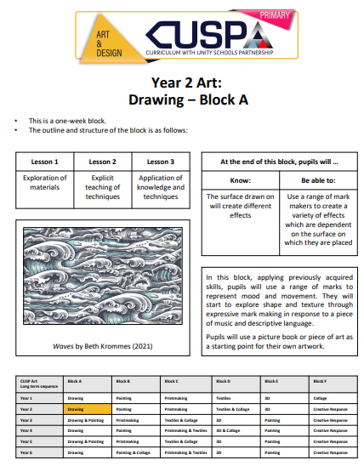
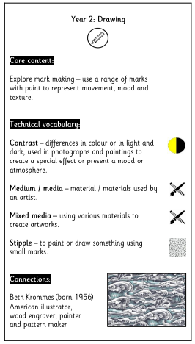
Overview of Block Contents and Knowledge Notes
Year 2 Overview of Block Contents
Implementation
Accompanying Year 2 Knowledge Note

Slide 14
Art & Design
Impact
Impact

Slide 15
Assessment
At the end of each block, teachers assess children’s knowledge and understanding against specific criteria. Knowledge is revisited at the beginning of subsequent lessons through a spaced practice approach to support retention.
Pupil book study
Subject leaders undertake pupil book studies to monitor the effectiveness of teaching and learning. This includes learning impact discussions with small groups of children using questioning to check and ensure vocabulary and knowledge has been learnt and understood. Subject leaders complete a report to inform teaching staff on areas of strength and those requiring improvement. This feedback informs future planning.
Impact

