Slide 1

Forest Schools
at Springfield Infant School and Nursery

Slide 2
Forest Schools
Intent
Intent

Slide 3
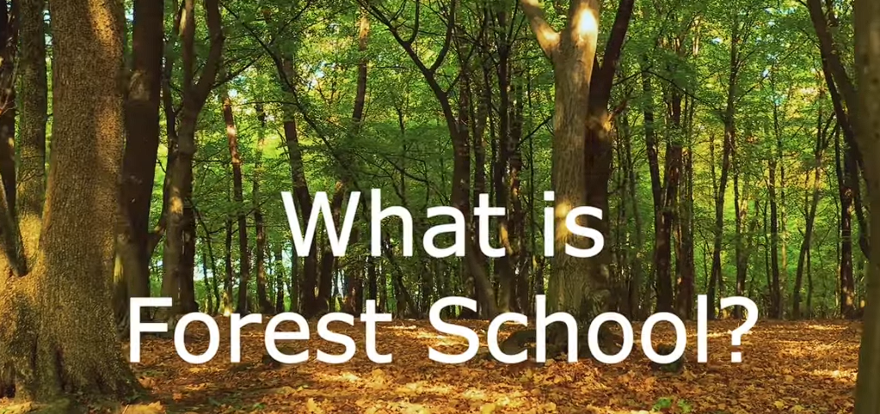
Intent
Click to watch this short clip from The Forest School Association
https://www.youtube.com/watch?v=8b2vC-ecUuU

Slide 4
Forest Schools at Springfield Infant School & Nursery
It is our intent that all children will experience some regular forest school sessions during their time at our school. We have a dedicated wildlife area on site with a pond and polytunnel to fulfil many exciting learning opportunities. Forest Schools is based on a fundamental respect for children and their capacity to investigate, test and maintain curiosity in the world around them…
It believes in children’s right to play;
The right to access the outdoors, in particular a woodland environment;
The right to access risk and the vibrant reality of the natural world;
The right to experience a healthy range of emotions, through all the challenges of social interaction,
To build resilience that will enable continued and creative engagement with their peers to reach their full potential.
Intent

Slide 5
What is Forest School?
We aim to follow the six basic Forest School Principles that shape and govern our ethos:
Principle 1: Forest School is a long-term process of frequent and regular sessions in a woodland or natural environment, rather than a one-off visit.
Principle 2: Forest School takes place in a woodland or natural environment (with trees where possible) to support the development of a relationship between the learner and the natural world.
Principle 3: Forest School aims to promote the holistic development of all those involved, fostering resilient, confident, independent and creative learners.
Principle 4: Forest School offers learners the opportunity to take supported risks appropriate to the environment and to themselves.
Principle 5: Forest School is run by qualified Forest School practitioners who continuously maintain and develop their professional practice.
Principle 6: Forest School uses a range of learner-centred processes to create a community for development and learning.
Intent

Slide 6
Forest Schools at Springfield Infant School - Progression of Skills
 | EYFS | KS1
Knots | I can tie a simple overhand knot. I can thread a wood cookie with support. I can wrap a stick independently. | I can tie a half hitch. I can explain how to tie knots and teach my peers. I can use simple knots to secure ropes and branches. I can make a basic friendship bracelet.
Shelters | I understand how to carry and use sticks/poles and ropes safely. I can make a mini den/ shelter/ home for a toy animal. | I understand that a shelter provides protection from the wind/ rain/ sun and can be used to live in. I can build a den. I can build a ridge line shelter. I can use a storm shelter.
Intent

Slide 7
 | EYFS | KS1
Fire lighting & cooking | I can follow fire circle safety. I know the respect position. I can follow & understand how to be safe around a fire. I can collect dry sticks. I can create a spark with the fire steel. I can safely use the fire for toasting - marshmallows/ bread/ fruit | I can explain the fire triangle. I can produce sparks with a fire steel. I can light a fire independently with cotton wool. I can lay a fire ready to light. I can follow and understand simple food hygiene. I can understand the need for completely extinguishing a fire. I can safely cook items on a stick over the fire.
Tools - knife | I can follow safety rules to whittle safely. | I can use a knife safely to create a simple object. I can explain the reason for the safety rules.
Tools - saw | I can follow and understand the safety rules to saw safely. I can use a saw with an adult partner. | I can use clamps/ stands appropriately to secure the wood. I can choose my saw appropriately to the work I am doing. I can use a saw safely with a peer partner.
Intent

Slide 8
 | EYFS | KS1
Tools - hammer mallet & froe | I can follow and understand the safety rules to use a hammer/ mallet. I can safely hammer use a hammer for simple tasks – e.g. tees into pumpkin/ potato or hapa zome. I can use a mallet and froe safely with an adult helper. | I can use a hammer with nails to make a simple object. I can use a mallet and froe safely with a peer/adult helper.
Tools - drills | I can follow and understand the safety rules to use a drill I can use a bit & brace/ rotary drill, palm drill with an adult helper. | I can use clamps appropriately to secure the wood. I can use a bit and brace/ rotary drill with a peer helper. I can use a palm drill independently (in green wood or conkers).
Other tools - Secateurs/loppers rakes, spade | I can follow and understand the safety rules to use secateurs/ loppers I can use a spade/hand shovel safely to dig independently. I can use loppers with adult help. | I can use secateurs/ loppers safely and independently. I can safely use a rake and a fork.
Intent

Slide 9
 | EYFS | KS1
Flora, fauna & nature | I can use pictorial ID guides. I can explain what a living thing needs to live and grow. I can identify a Silver Birch tree I can identify differences between seasons. I can find 5 different minibeasts | I can identify a Hazel tree. I can identify the difference between living and dead trees and plants. I can use an ID guide to identify some common birds. I can use an ID guide to identify a variety of common fauna including pond creatures. I can use an ID guide to identify a variety of common trees, plants and flowers. I can talk about pollination confidently. I can name some common birds and talk about their features. I can identify some common birds through their songs with some adult help. I can talk about why and understand how to encourage wildlife into an area. I can match tracks and other signs to particular animals. I can name/identify different animal habitats.
Problem solving and teamwork | I can work in a team. I can play team games, listening to and following instructions. | I can play team games independently without adult intervention. I can think about how to solve problems before asking a grown-up for help.
Intent

Slide 10
 | EYFS | KS1
Art | I can use natural materials to create artwork that I can talk about. I can print using natural materials. I can create examples of hapa zome. | I can use hapa zome, natural paints/ inks to create artwork. I can observe features and colours to make a representation in art. I can use clay/ mud to create animals/ sculptures, additional usage of natural materials to decorate.
Oracy | I can talk about something I have learnt or an aspect of safety. I can talk and listen with a talk partner. | I am usually confident to speak when in the fire circle. I can use the story dice to take turns speaking and creating a story.
Intent

Slide 11
 | EYFS | KS1
Physical literacy and healthy lifestyle | I know how to travel safely on rough ground. I can carry sticks safely and can lift heavy objects safely. I can carry equipment around safely. I can follow and make trails and obstacle courses. I can use my coordination and balance to walk along the rope bridge. I can independently get on and off the swing and use it safely. I can independently get on and off the hammock and use it safely. | I can use my finger strength to tie ropes and knots. I can use my strength and fine motor skills to light a fire. I can use my hand eye coordination to hit a nail into the wood. I can use my strength to use the secateurs/ loppers. I can dig, rake, shovel and use the wheelbarrow efficiently.
Intent

Slide 12
Forest Schools
Implementation
Implementation

Slide 13
How will I see the principles in action?
Principles 1 & 2: Children come outside for weekly forest school sessions, usually for half a term at a time (two half terms per year). Sessions take place in nearly all weathers (thunder & lightning or high winds are the exceptions). Our site has a small collection of trees and with the children, we aim to plant further trees to enhance the area further.
Implementation

Slide 14
How will I see the principles in action?
Principles 3 & 6: Forest school is centred around the children themselves with no specific curriculum drivers. This means there is rarely a classroom curriculum objective that the children need to achieve although the ‘hook’ of the session may be linked to classroom topics. Sometimes we will include an outdoor learning session where an objective would be appropriate. The learning is in the experience itself rather than being content heavy.
Sessions aim to develop personal, social skills and creativity:
team work, communication, problem solving
physical, mental and emotional health
children are active throughout, being outside can help to meet sensory needs and give space to think and process what is going on in their lives;
children may create their own songs, rhymes, stories, imaginative play and games or may be creative in the mud kitchen, creating transient art, using tools or in other ways.
Implementation

Slide 15
How will I see the principles in action?
Principle 4 : Children may be set group challenges as part of a session but children are encouraged to seek out their own challenges – getting a rope into the tree to make a swing, building platforms or bridges to incorporate into their games, climbing, creating a fairy garden, building a shelter, digging a hole big enough to stand inside, finding ways to look after and enhance our Forest School area and more.
Principle 5: We have two members of staff who are qualified Forest School Level 3 practitioners and one holds an outdoor paediatric first-aid qualification. 10 members of staff are paediatric first-aid trained and 19 members of staff hold first-aid at work qualifications.
Implementation

Slide 16
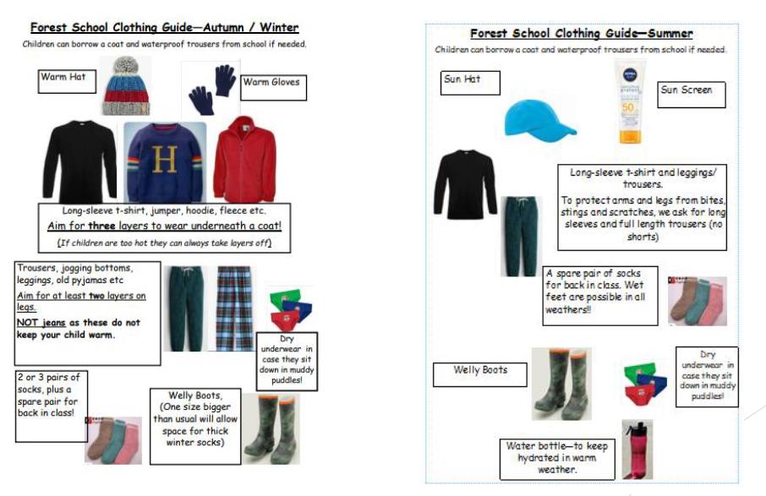
Clothing - For children to feel comfortable outdoors they must be dressed appropriately. We encourage children to come to school, Forest School ready but provide waterproof jackets and trousers if required.
Implementation
With thanks to Rosebrook Primary School for the images

Slide 17
Forest School
Impact
Impact

Slide 18
Assessment
We follow the Forest School ethos, emphasising child-led learning; the leader becomes the facilitator, supporting children in exploring the areas that interest and motivate them. This child-led approach has significant benefits supporting children in developing independence, confidence, creativity, perseverance and resilience, essential life skills. Therefore our sessions meet the needs of the whole child.
Impact

Slide 19
Assessment
Observations are carried out during each session and reflections made after each session feed into subsequent planning. We review our weekly plans based upon these observations and so centre on children’s individual needs and interests. Knowledge is revisited throughout the block of sessions to support retention. At the end of each block of sessions, leaders assess children’s knowledge and understanding against the progression of skills statements to inform future planning.
Impact

Slide 20
Key themes from attending Forest School
Confidence
This is characterised by self-confidence and self-belief that comes from the children having the freedom, time and space, to learn, grow and demonstrate independence.
Social skills
The children demonstrate an increased awareness of the consequences of their actions on other people, peers and adults, and acquire a better ability to work co-operatively with others.
Language and communication
The children develop their spoken language prompted by their visual and sensory experiences at Forest School.
Motivation and concentration
This is characterised by a keenness to participate in exploratory learning and play activities as well as the ability to focus on specific tasks for extended periods of time.
Impact

Slide 21
Key themes found from attending Forest School
Physical skills
The children develop physical stamina and their gross motor skills through free and easy movement round the Forest School site. They develop fine motor skills by making objects and structures.
Knowledge and understanding
Increased respect for the environment is developed as well as an interest in their natural surroundings. Observational improvements are enhanced as the children start to identify flora and fauna.
New perspectives
The teachers and practitioners gain a new perspective and understanding of the children as they observe them in a very different setting and are able to identify their individual learning styles.
Ripple effects beyond Forest School
We hope in time that the children will take their experience home and ask their parents to take them outdoors at the weekend or in the school holidays. Most parents are positive about Forest Schools but for some we hope that their interest and attitude towards Forest School will change as they see the postive impacts on their children.
Impact

Slide 22
In short, Forest School is…
Child led, child focused, holistic.

Slide 23
In short, Forest School is…
In a natural environment

Slide 24
In short, Forest School is…
May include bush-craft where appropriate.

Slide 25
In short, Forest School is…
Learning through play, exploration and managing risk.

Slide 26
In short, Forest School is…
Experienced regularly over a long period of time.

