Slide 1

Geography
Intent
Intent

Slide 2
Geography
Geography at Springfield Infant School & Nursery
It is our intent that all children will understand what it is to be a 'geographer'. For our children this will mean learning about places, the world and the people living in it. We will ensure children are given the opportunities and practical experiences to learn about people and places around the world. Geography will be taught with a keen focus on developing a secure knowledge of where they live; of their own local area and of the United Kingdom. Opportunities will be given to develop a range of geographical skills, including how to use maps, atlases and globes, alongside fieldwork and observational experiences. Through specific teaching of subject specific terminology we aim to provide the children with a core vocabulary to use. This will provide them with the skills and confidence to express themselves and to communicate their ideas clearly, using geographical terms.
Intent

Slide 3
Geography
Aims of the Geography Curriculum
The national curriculum for Geography aims to ensure that all pupils:
develop contextual knowledge of the location of globally significant places – both terrestrial and marine – including their defining physical and human characteristics and how these provide a geographical context for understanding the actions of processes
understand the processes that give rise to key physical and human geographical features of the world, how these are interdependent and how they bring about spatial variation and change over time
are competent in the geographical skills needed to:
collect, analyse and communicate with a range of data gathered through experiences of fieldwork that deepen their understanding of geographical processes
interpret a range of sources of geographical information, including maps, diagrams, globes, aerial photographs and Geographical Information Systems (GIS)
communicate geographical information in a variety of ways, including through maps, numerical and quantitative skills and writing at length.
Intent

Slide 4
Geography
Early Years
In Early Years, geography is taught through Understanding the world: The World. Understanding the world involves guiding children to observe, compare and make sense of their physical world and their community.
Our curriculum is designed to provide children with regular opportunities to make sense of their physical world and their community.
Children are encouraged to do this by being provided opportunities to:
Observe detailed features of objects in their environment.
Comment on and ask questions about aspects of their familiar world such as the place where they live or the natural world.
Observe their local environment through local area walks, photographs and online technology.
Use maps and small world resources to create and represent environments.
Listen to stories and participate in discussions related to climate change, habitat and erosion.
Develop appropriate vocabulary to help make distinctions in their observations.
Intent

Slide 5
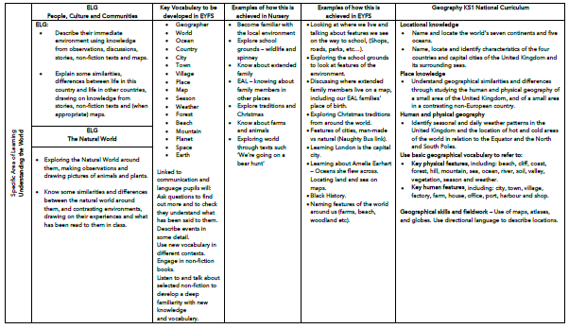
Content and sequence - EYFS to Key Stage 1
Intent

Slide 6
Spaced Retrieval Practice Approach
Our geography curriculum is delivered through a series of modules which are deliberately spaced throughout the academic year with opportunities to introduce and revisit key concepts. This approach enables staff to deepen pupil understanding and embed learning.
Our curriculum maps clearly show how our CUSP curriculum delivers (introduces and revisits) the National Curriculum expectations for geography within and across year groups.
Intent

Slide 7
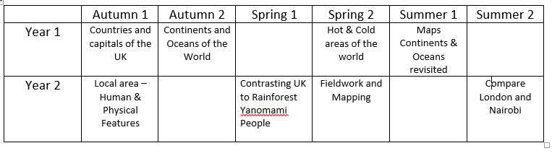
Year 1 & 2 Overview
Intent

Slide 8
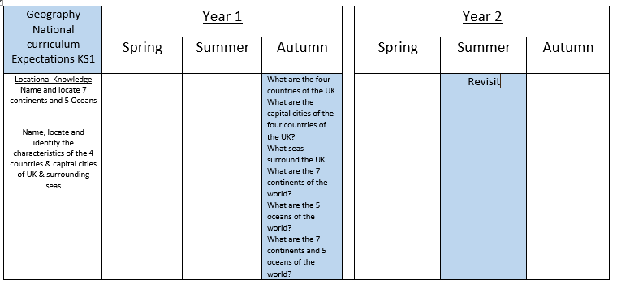
Year 1 & 2 Progression Map
Intent

Slide 9
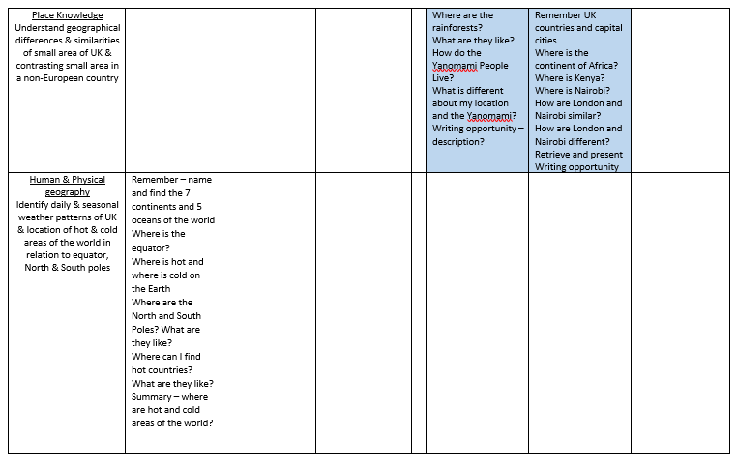
Year 1 & 2 Progression Map
Intent

Slide 10
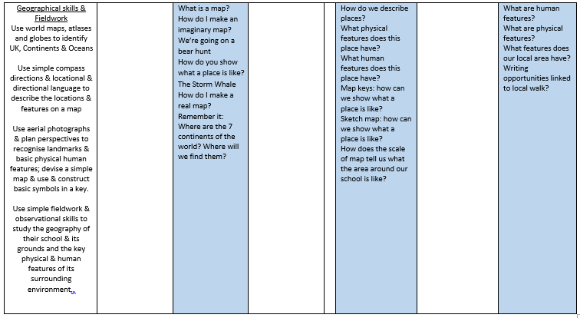
Year 1 & 2 Progression Map
Intent

Slide 11
Geography
Implementation
Implementation

Slide 12
How do we teach Geography?
At Springfield Infant School and Nursery, Geography is taught across each year group in modules that enable pupils to study in depth key Geographical understanding, skills and vocabulary. Each module aims to activate and build upon prior learning, including EYFS, to ensure better cognition and retention. Each module is carefully sequenced to enable pupils to purposefully layer learning from previous sessions to facilitate the acquisition and retention of key Geographical knowledge. Each module is revisited either later in the year or in the following year as part of a spaced retrieval practice method to ensure pupils retain key knowledge and information.
Implementation

Slide 13
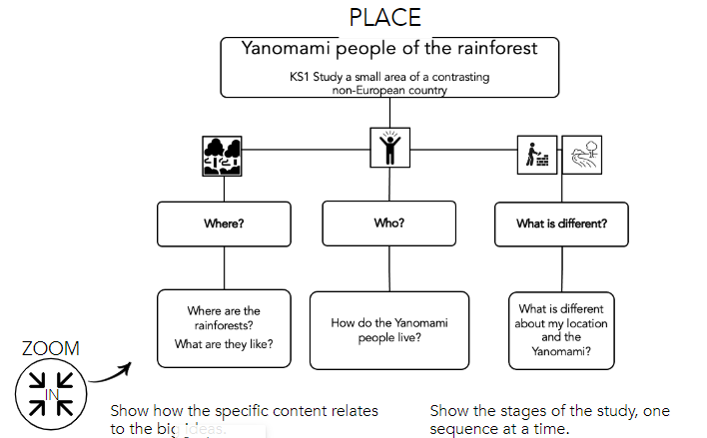
The Big Ideas
At Springfield Infant School, we put an emphasis on sharing the big ideas with the children at the beginning of every module.
Implementation

Slide 14
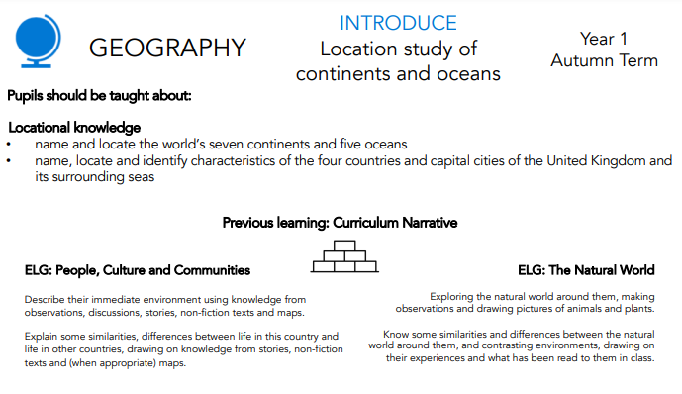
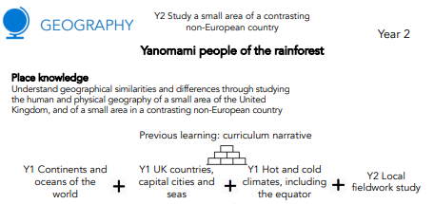
National Curriculum objectives and how these links to prior learning are evident at the beginning of every module.
A Year 1 module showing how the learning builds upon EYFS
Implementation
A Year 2 module building on prior learning from Year 1.

Slide 15
Knowledge organisers and Knowledge Notes
Accompanying each module is a Knowledge Organiser which contains key vocabulary, information and concepts which all pupils are expected to understand and retain. Knowledge notes are the elaboration and detail which help pupils acquire the content of each module. They support vocabulary and concept acquisition through a well-structured sequence that is cumulative. Each Knowledge Note begins with questions, focussing on key content to be learnt and understood. Knowledge Organisers and Knowledge Notes are dual coded to provide pupils with visual calls to aid understanding and recall. Knowledge Organisers and Knowledge Notes are referenced throughout each module.
Implementation

Slide 16
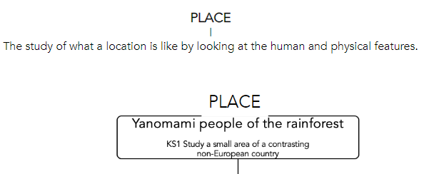
Substantive Knowledge
The knowledge organiser outlines the minimum substantive knowledge expectations, this is the subject knowledge and explicit vocabulary used to learn about the content.
The substantive concepts are the vehicle to connect substantive knowledge.
In Geography they are:
Location knowledge
Place knowledge
Human and physical geography
Geographical skills and fieldwork
Implementation

Slide 17

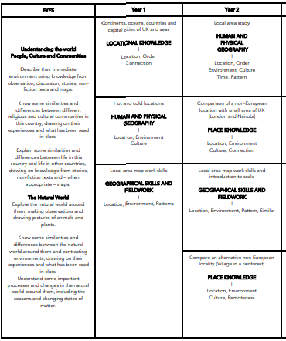
Substantive Concepts
Implementation

Slide 18
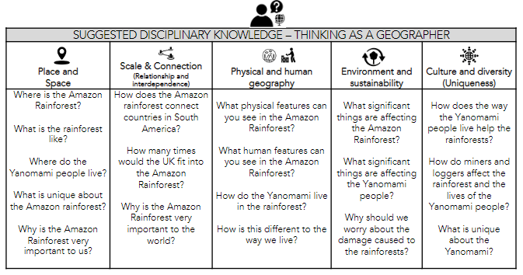
Disciplinary Knowledge
To help children make sense of the substantive knowledge, teachers use disciplinary knowledge tasks. Children are taught to think as a Geographer , providing challenge to enable children to think hard about the content, creating a coherent long-term memory.
In Geography they are:
Chronology (the sequence of time)
Cause and consequence (the reason and result of the things that happened in history)
Change and continuity (how key people, places and events changed or stayed the same over time)
Similarity and difference
Evidence (how we know about the past)
Significance (Why people, events and ideas
are important in our studies
Each knowledge note has a learning question that
gives children the opportunity to attempt and apply
their understanding of the substantive knowledge (what children know) in a disciplinary way (what children do). These culminate towards a more expert understanding of the big idea.
Implementation

Slide 19
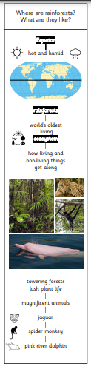
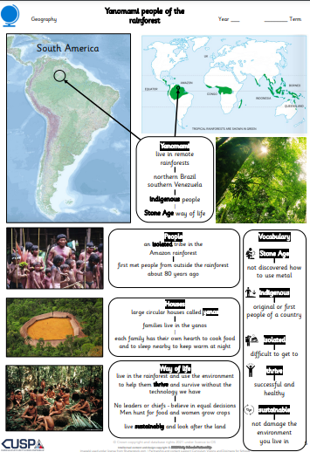
Knowledge organisers and Knowledge Notes
Year 2 Knowledge Organiser
Implementation
Accompanying Year 2 Knowledge Note

Slide 20
Geography
Impact
Impact

Slide 21
Assessment
At the end of each block, teachers assess children’s knowledge and understanding against specific criteria. Knowledge is revisited at the beginning of subsequent lessons through a spaced practice approach to support retention.
Pupil book study
Subject leaders undertake pupil book studies to monitor the effectiveness of teaching and learning. This includes learning impact discussions with small groups of children using questioning to check and ensure vocabulary and knowledge has been learnt and understood. Subject leaders complete a report to inform teaching staff on areas of strength and those requiring improvement. This feedback informs future planning.
Impact

