Slide 1

Science
Intent
Intent

Slide 2
Science
At Springfield Infants and Nursery we will ensure that our children are curious and inquisitive and take pleasure in learning about the world around them. We will encourage them to think independently, become problem solvers and ask questions. We will enable and support them to be confident in a range of practical and logical skills and encourage them to have an enquiring mind and develop a scientific vocabulary. We will support them to have an increasing confidence in expressing their own ideas and sharing their experience and knowledge.
Through fostering a scientific knowledge and skills base we aim to develop scientists who have a lifelong curiosity and passion for science.
Intent

Slide 3
Science
Aims of the Science Curriculum
The national curriculum for science aims to ensure that all pupils:
- develop scientific knowledge and conceptual understanding through the specific disciplines of biology, chemistry and physics
- develop understanding of the nature, processes and methods of science through different types of science enquiries that help them to answer scientific questions about the world around them
- are equipped with the scientific knowledge required to understand the uses and implications of science, today and for the future.
Intent

Slide 4
Science
Early Years
In Early Years, science is taught through Understanding the World –
‘The World.’ Our curriculum is designed to guide children to explore the world around them enabling them to make sense of the natural world.
Children are encouraged to do this by:
Exploring different materials, forces and their natural environment.
Exploring change in seasons, states of matter and change over time.
Making observations and talking about plants, animals and natural objects.
Exploring similarities and differences between materials and living/naturally occurring things.
Exploring how things work and why things happen.
Exploring respect and care for the environment and living things.
Explore the effect of their behaviour on the environment.
Being curious, commenting and asking questions about the natural world.
Intent

Slide 5
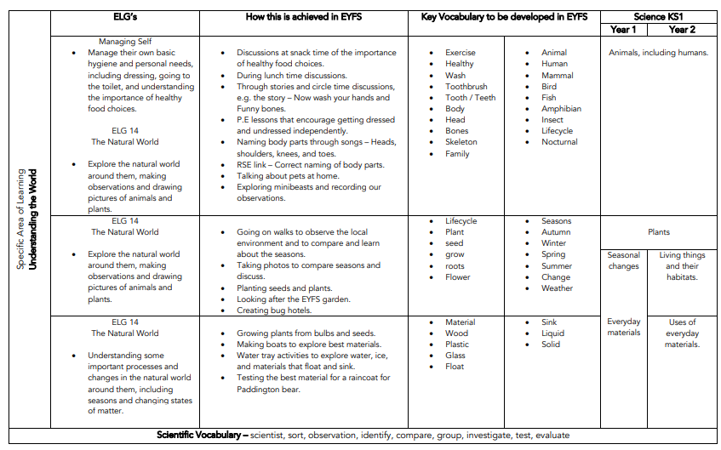
Content and sequence - EYFS to Key Stage 1
Intent

Slide 6
Spaced Retrieval Practice Approach
Our science curriculum is delivered through a series of modules which are deliberately spaced throughout the academic year with opportunities to introduce and revisit key concepts. This approach enables staff to deepen pupil understanding and embed learning.
Our curriculum maps clearly show how our CUSP curriculum delivers (introduces and revisits) the National Curriculum expectations for science within and across year groups.
Intent

Slide 7
Year 1 & 2 Overview
CUSP Science Long Term Sequence | Autumn 1 | Autumn 2 | Spring 1 | Spring 2 | Summer 1 | Summer 2
Year 1 | Seasonal Changes Intro to plants (trees) | Animals incl humans | Materials | Plants | Revisit Animals incl humans | Revisit plants
Year 2 | Living things and their habitats | Materials | Animals incl humans | Plants Revisit Materials | Revisit plants | Revisit living things and their habitats
Intent

Slide 8
Year 1 & 2 Progression Map
SCIENCE National Curriculum Expectations KS1 | Year 1
 | Autumn | Spring | Summer
Plants identify and name a variety of common wild and garden plants, including deciduous and evergreen trees identify and describe the basic structure of a variety of common flowering plants, including trees. | Introduce trees What makes a tree? Types around school. Differences. | Introduce parts of a plant. Structures Wild and garden – where? | Revisit Plants (as before)
Animals, including humans identify and name a variety of common animals including fish, amphibians, reptiles, birds and mammals identify and name a variety of common animals that are carnivores, herbivores and omnivores describe and compare the structure of a variety of common animals (fish, amphibians, reptiles, birds and mammals, including pets) identify, name, draw and label the basic parts of the human body and say which part of the body is associated with each sense. | Introduce What is an animal? Types. Similarities/diff’s Eating/food. What makes me an animal + senses? |  | Revisit Features of diff groups. Compare
Everyday materials distinguish between an object and the material from which it is made identify and name a variety of everyday materials, including wood, plastic, glass, metal, water, and rock describe the simple physical properties of a variety of everyday materials compare and group together a variety of everyday materials on the basis of their simple physical properties. |  | Introduce - What are materials? What are things made of in school? Properties –describe. Waterproof. Transparent/ Opaque? Best material for the job? Why?
Seasonal changes observe changes across the four seasons observe and describe weather associated with the seasons and how day length varies. | Introduce- What are the 4 seasons? Weather? Why does day become night?
Intent

Slide 9
SCIENCE National Curriculum Expectations KS1 | Year 2
 | Autumn | Spring | Summer
Living things and their habitats explore and compare the differences between things that are living, dead, and things that have never been alive identify that most living things live in habitats to which they are suited and describe how different habitats provide for the basic needs of different kinds of animals and plants, and how they depend on each other identify and name a variety of plants and animals in their habitats, including micro- habitats describe how animals obtain their food from plants and other animals, using the idea of a simple food chain, and identify and name different sources of food. | Introduce Alive & not. Living things – common characteristics Where plants & animals live, what in our local environ? Foodchains. Plants & animals need each other. |  | Revisit Alive, not alive, never alive.
Plants observe and describe how seeds and bulbs grow into mature plants find out and describe how plants need water, light and a suitable temperature to grow and stay healthy. |  | Introduce Seeds – how germinate. Bulbs – how sprout and grow? Plant needs, what happens if not? Needs to be healthy. Plants around school – healthy or unhealthy? | Revisit How do seeds and bulbs grow & needs for health.
Animals, including humans notice that animals, including humans, have offspring which grow into adults find out about and describe the basic needs of animals, including humans, for survival (water, food and air) describe the importance for humans of exercise, eating the right amounts of different types of food, and hygiene. |  | Introduce How animals change as mature. Needs to stay alive. Health – exercise & food.
Uses of everyday materials identify and compare the suitability of a variety of everyday materials, including wood, metal, plastic, glass, brick, rock, paper and cardboard for particular uses find out how the shapes of solid objects made from some materials can be changed by squashing, bending, twisting and stretching. | Introduce What used for? Categorise – wood, metal, plastic, glass, ceramic, rock, paper, card, fabric. Change – squash, bend, twist, stretch. Right material for job. Absorbent & waterproof. | Revisit What is it made of? What materials pets have/need?
Intent

Slide 10
Science
Implementation
Implementation

Slide 11
How do we teach science?
At Springfield Infant School and Nursery, science is taught across each year group in modules that enable pupils to study in depth key scientific understanding, skills and vocabulary. Each module aims to activate and build upon prior learning, including EYFS, to ensure better cognition and retention. Each module is carefully sequenced to enable pupils to purposefully layer learning from previous sessions to facilitate the acquisition and retention of key scientific knowledge. Each module is revisited either later in the year or in the following year as part of a spaced retrieval practice method to ensure pupils retain key knowledge and information.
Implementation

Slide 12
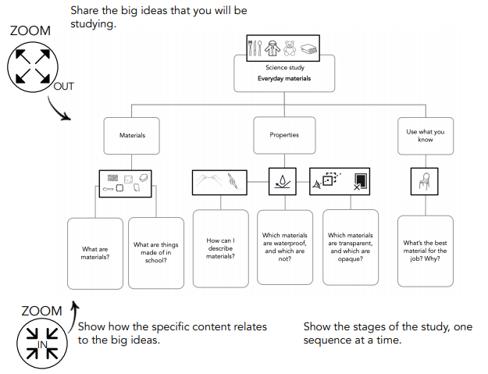
The Big Ideas
At Springfield Infant School, we put an emphasis on sharing the big ideas with the children at the beginning of every module.
Implementation

Slide 13
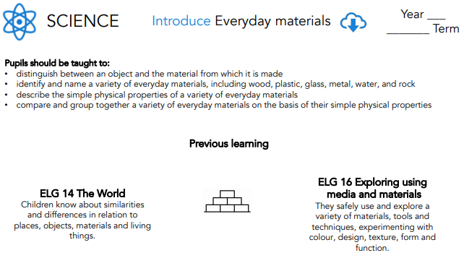
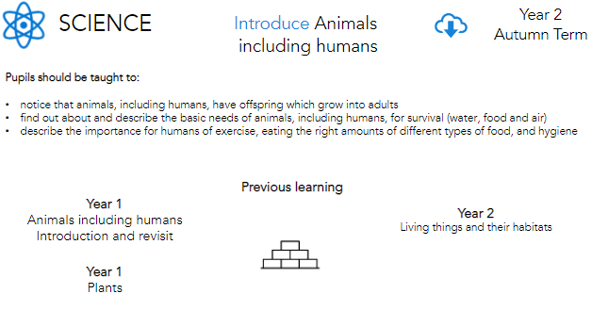
National Curriculum objectives and how these links to prior learning are evident at the beginning of every module.
A Year 1 module showing how the learning builds upon ELGs.
Implementation
A Year 2 module building on prior learning of Animals including humans from Years 1.

Slide 14
Knowledge organisers and Knowledge Notes
Accompanying each module is a Knowledge Organiser which contains key vocabulary, information and concepts which all pupils are expected to understand and retain. Knowledge notes are the elaboration and detail which help pupils acquire the content of each module. They support vocabulary and concept acquisition through a well-structured sequence that is cumulative. Each Knowledge Note begins with questions, focussing on key content to be learnt and understood. Knowledge Organisers and Knowledge Notes are dual coded to provide pupils with visual calls to aid understanding and recall. Knowledge Organisers and Knowledge Notes are referenced throughout each module.
Implementation

Slide 15
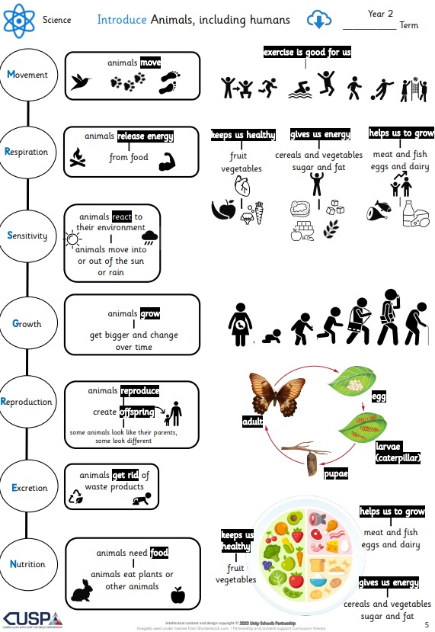
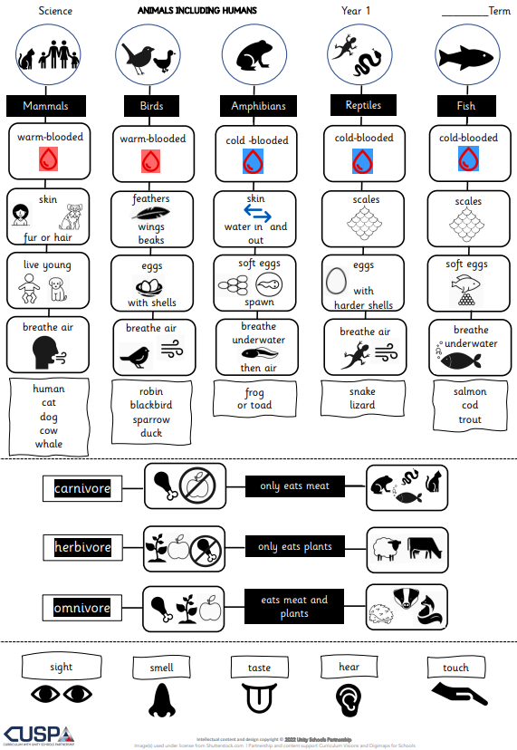
Substantive Knowledge
The knowledge organiser outlines the minimum substantive knowledge expectations, this is the subject knowledge and explicit vocabulary used for finding out about the world around us.
Year 2 Knowledge Organiser
Year 1
Knowledge Organiser
Implementation

Slide 16
Disciplinary Knowledge
To help children make sense of the substantive knowledge, teachers use disciplinary knowledge tasks. Children are taught to think as a scientist and work scientifically, children are challenged to think hard about the content, creating a coherent long-term memory.
Each knowledge note has a learning question that gives children the opportunity to attempt and apply their understanding of the substantive knowledge (what children know) in a disciplinary way (what children do). These culminate towards a more expert understanding of the big idea.
Working Scientifically
At Springfield Infants children will gradually build on their scientific skills throughout the Key Stages based on National Curriculum expectations.
Key Stage 1:
• Asking simple questions and recognising that they can be answered in different ways.
• Observing closely, using simple equipment.
• Performing simple tests.
• Identifying and classifying.
• Using their observations and ideas to suggest answers to questions.
• Gathering and recording data to help in answering questions.
Implementation

Slide 17
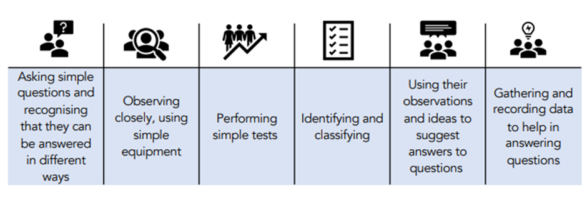
Development of Scientific Skills
As well as ensuring pupils are taught key knowledge, each module is designed to offer pupils the opportunity to undertake scientific enquiries and develop their skills as a Scientist in asking questions, planning and carrying out experiments, collecting and analysing information and drawing conclusions. At Springfield Infants, the working scientifically objectives are clearly displayed in each of our science learning sequences. It is clear which of the objectives are being taught throughout a specific module which ensures full coverage and allows for skills to be built upon.
Implementation

Slide 18
Science
Impact
Impact

Slide 19
Assessment
At the end of each block, teachers assess children’s knowledge and understanding against specific criteria. Knowledge is revisited at the beginning of subsequent lessons through a spaced practice approach to support retention.
Pupil book study
Subject leaders undertake pupil book studies to monitor the effectiveness of teaching and learning. This includes learning impact discussions with small groups of children using questioning to check and ensure vocabulary and knowledge has been learnt and understood. Subject leaders complete a report to inform teaching staff on areas of strength and those requiring improvement. This feedback informs future planning.
Impact

